Slide 1
Evolve or Die
The Changing Nature of Associations in the Digital Landscape
Chloe Menhinick
International Water Association
UIA European Round Table, November 2016, Monaco
Notes:
Good afternoon everyone!
Evolve or Die! Wow. Was I having a bad day when I came up with this title?
There certainly is a real sense of fatalism in this title! And by the time I had finished my presentation I reaffirmed to myself that indeed, as the landscape of Associations changes, it’s legitimate to ask whether we can survive the 21st century? Whether, without a radical transformation in the way we do business and the way we engage with our stakeholders, can we fulfill our purpose and mission?
But before I go on let me introduce myself, I am Chloe Menhinick- Network Engagement Manager for The International Water Association. My role over the last 3 years has been focused on leading our Association on a journey of change to digitalize our membership experience .
When I first considered this opportunity to give this key note here in Monaco, it was July 2015- a year and a half back down the line- and I had been engaged in this process for about a year . Already at that time, I felt sure that this would be an experience I wanted to share. So here I am, and this is my story about a journey of evolution of our Association,
Like all stories, our story consists of a Plot, , A Protagonist, a Hero and a Morale.

Slide 2
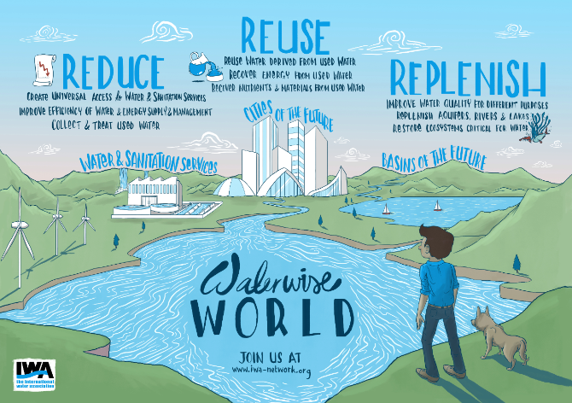
Notes:
The International Water Association (or the IWA) for short is a professional membership association with a strong purpose driven mission and vision to create a water-wise world- a world in which clean water is available for all and one in which our water eco-systems are healthy and thriving. Our members come together through the IWA community to share best practice and knowledge on the best water –technology solutions to meet the future challenges of the worlds pressing water issues.
The International Water Association was established following a merger in 1999. By the time I joined in 2005, the established membership model was comprised of membership packages for individuals and organizations and once the dust from the merger had settled, the next 5 years of the Associations life cycle would experience positive growth of membership, buoyed by our expanding Publications arm- IWA Publishing and our breadth of programmes to cater for the needs of our members. I was heading a department focused purely on membership & marketing, our renewal cycle was well established and renewal campaigns strongly managed resulting in retention levels averaging at 88% at the peak of membership in 2008.
And then (and this will no doubt be a familiar story to many Association professionals) – in 2009 the financial crisis hit. Surprisingly, for the next couple of years, the IWA seemed to have been shielded for the most part by the crisis which other Associations were struggling against. Our retention rates continued on a positive trajectory of growth. The first signs of the shock waves of the global crisis started to show initially in the acquisition of new corporate members, the downgrading of membership packages of some of our well established corporates and particularly in the growth of our well established traditional markets in North America and Europe.
Like many other Associations, securing renewals and acquisition of new members become increasingly difficult with members questioning the very point of membership at a time when the membership value proposition was being eroded. These realities pushed us to look at increasing efficiencies and reducing costs in our membership fulfillment processes. The obvious decision was to move our membership away from the paper driven, approach we had relied on for the past decade and move the membership rees and appliaiton prcess to a fully digital proposition. Abd thus, wmbarked upon a journey to move our Association from an analogue world to a digital world.
In XX 2015, The World Economic Forum put water at the top of its global risk charter. Water was placed at the heart of the process that were to become the Sustainable Development Goals. Governments and industry were prioritising water as never before. The water profession and water professionslas were suddenly in the economic and social spotlight..what an opportunity and responsibility for a puroise driven professional association like the IWA.
An organisation with a clear purpose needs to be able to communicate it to current and future stakeholders, the IWA members and supporters of the future.
It needs to not only be an authorative voice within its exisitng networks, but also be able to influence people from outside its traditional scope on issues that drive its vision. This isn’t a nice to have- in our networked world its necessary just to remain relevant.

Slide 3
THE Protagonist : The networked world
Notes:
So now that Ive set the scene, lets move on to the characters of our story:
Starting with the Protagonists: First off- The Networked World.
In this new world, digital communications are owned by everyone and can be seen by anyone. Digital is no longer solely the remit of IT, but an essential function throughout all areas of an organisation.

Slide 4
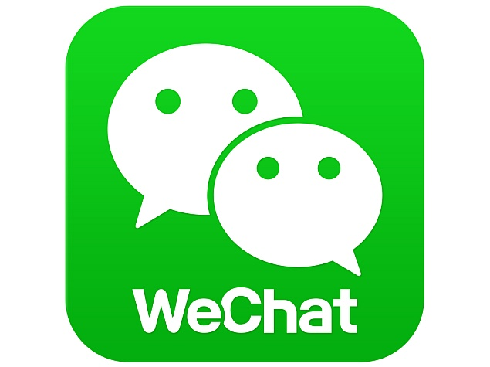
Digital NETWORKS driving engagement
IWA is professional: LinkedIn
Different audiences, demogrpahics turn to alternative sites: Facebook, Wechat
Growing inside and outside IWA
Notes:
The benefits of membership are no longer ‘just in the hands of associations’. In a digital society, the personal and the professional has became less distinct.
People share content more freely and are pushing increasingly for open access.
Content has became available through different channels, virtual platforms and social media.
The growth of virtual communities and digital media allowed people to network in unprecedented ways and at unprecedented speed.

Slide 5
THE ELEPHANT IN THE ROOM
Notes:
But the networked world is not our only protagnaist.
If you picture the networked world as the cheetah, we are by contrast the elephant. We, and by we I mean Associations can be characterized by our longevity, our routine, our primary concern with safeguarding membership as one of our primary revenue streams. And whist these were at one time all virtues, these values are also the root cause of our aversion to risk, our trepidation about changing the status quo. We are becoming our own worst enemy. And the wise, old elephant is dragging its heavy load in a battle of survival against the agile, nimble and quick cheater. T
Our inability to adapt and respond quickly to the ever-changing tides and currents of the digital world is increasingly working against us, for in this networked world we now live in, if we aren’t providing the platforms for our members to connect virtually, the likelihood that someone else will is almost an inevitability.

Slide 6
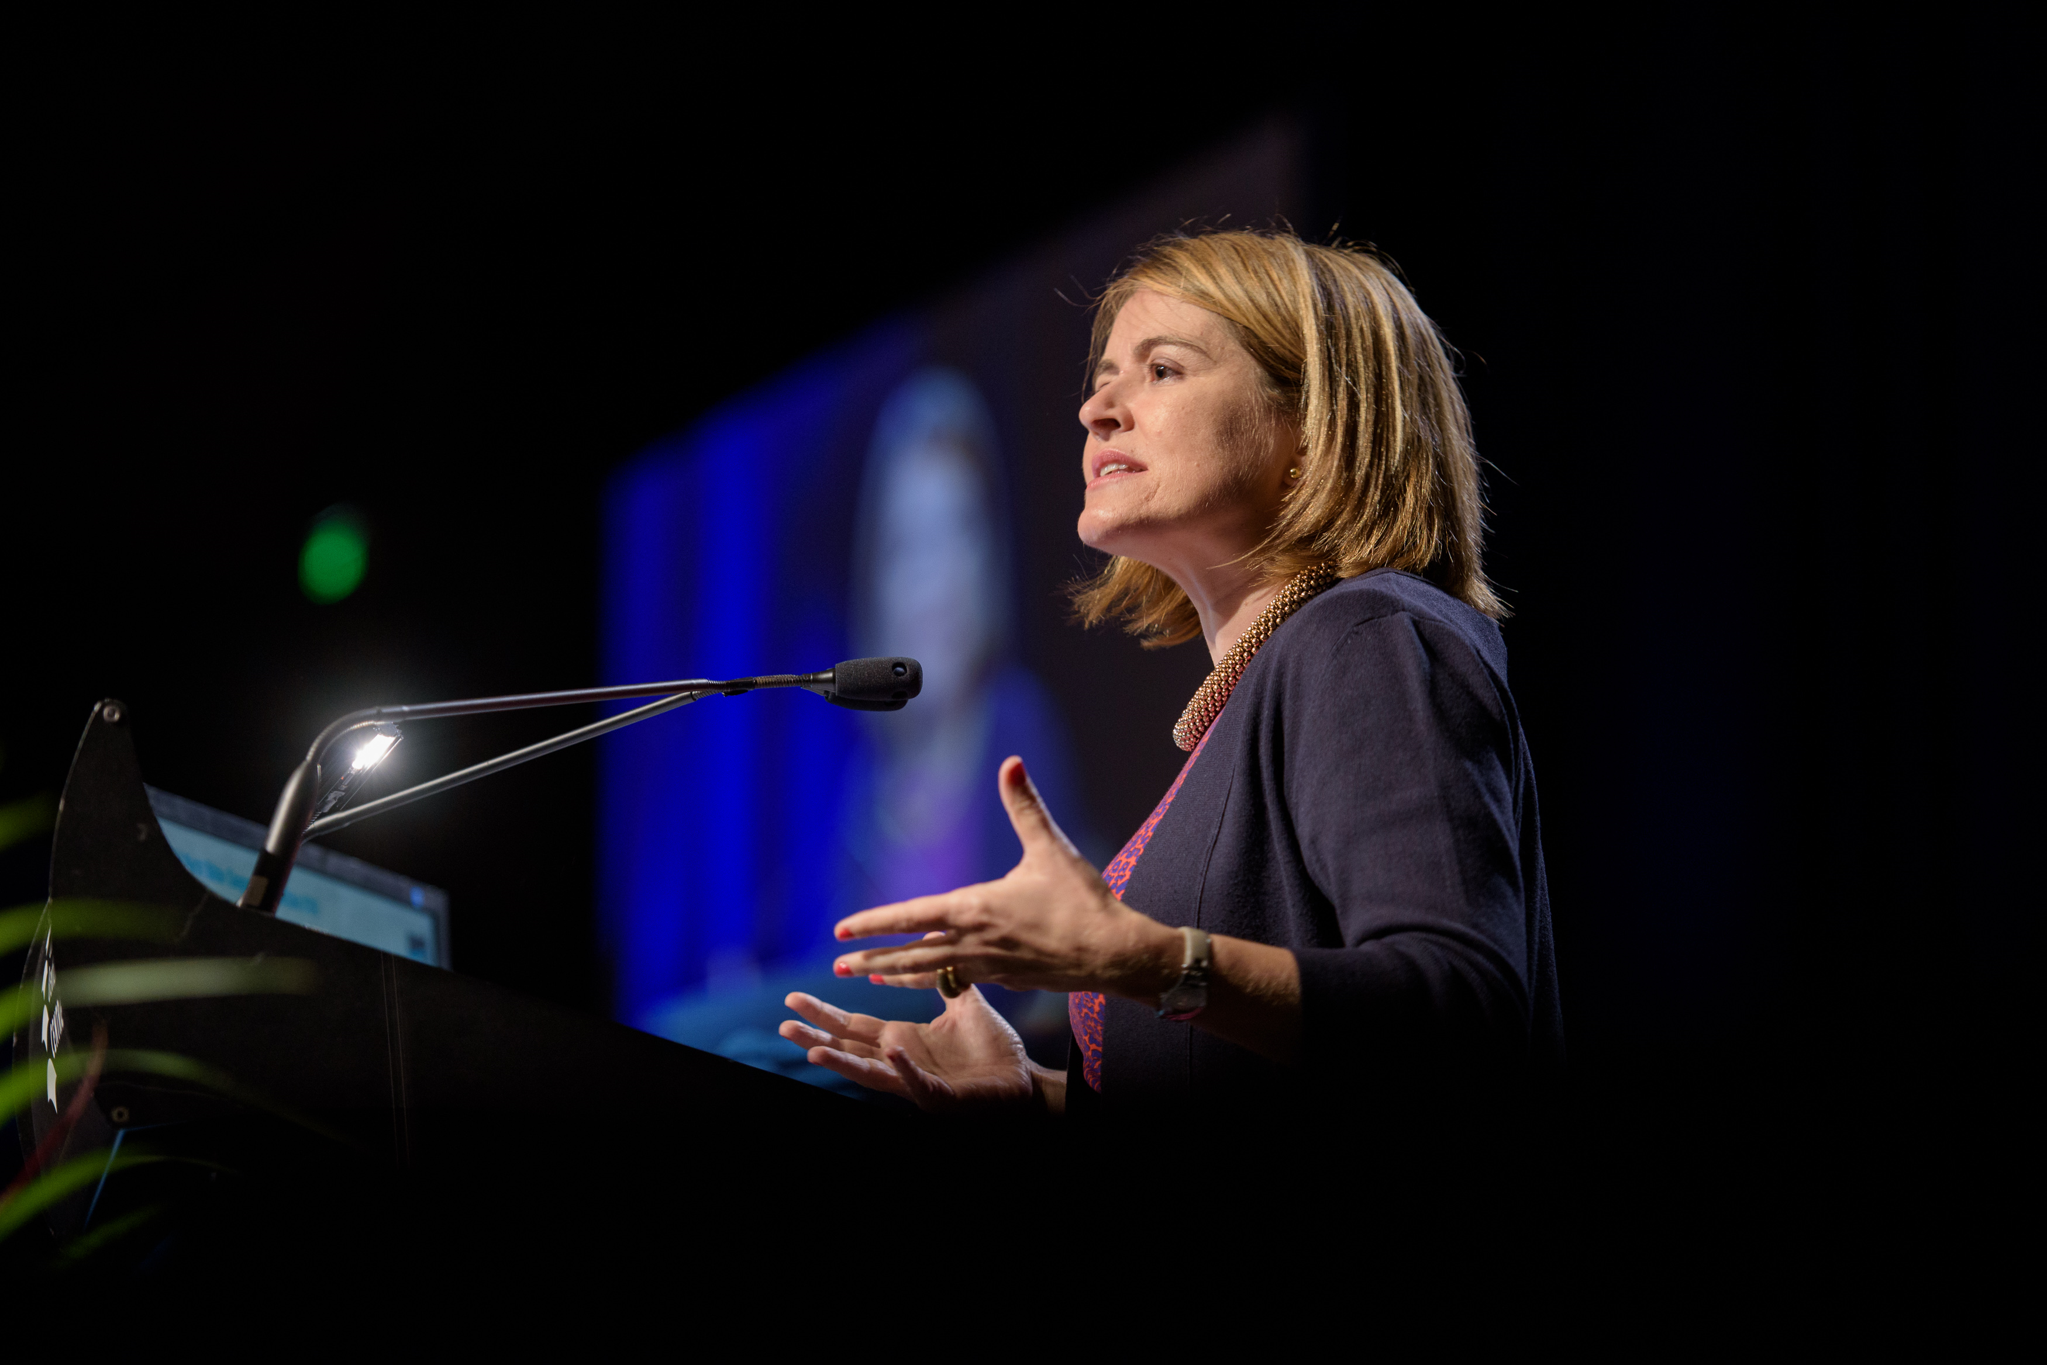
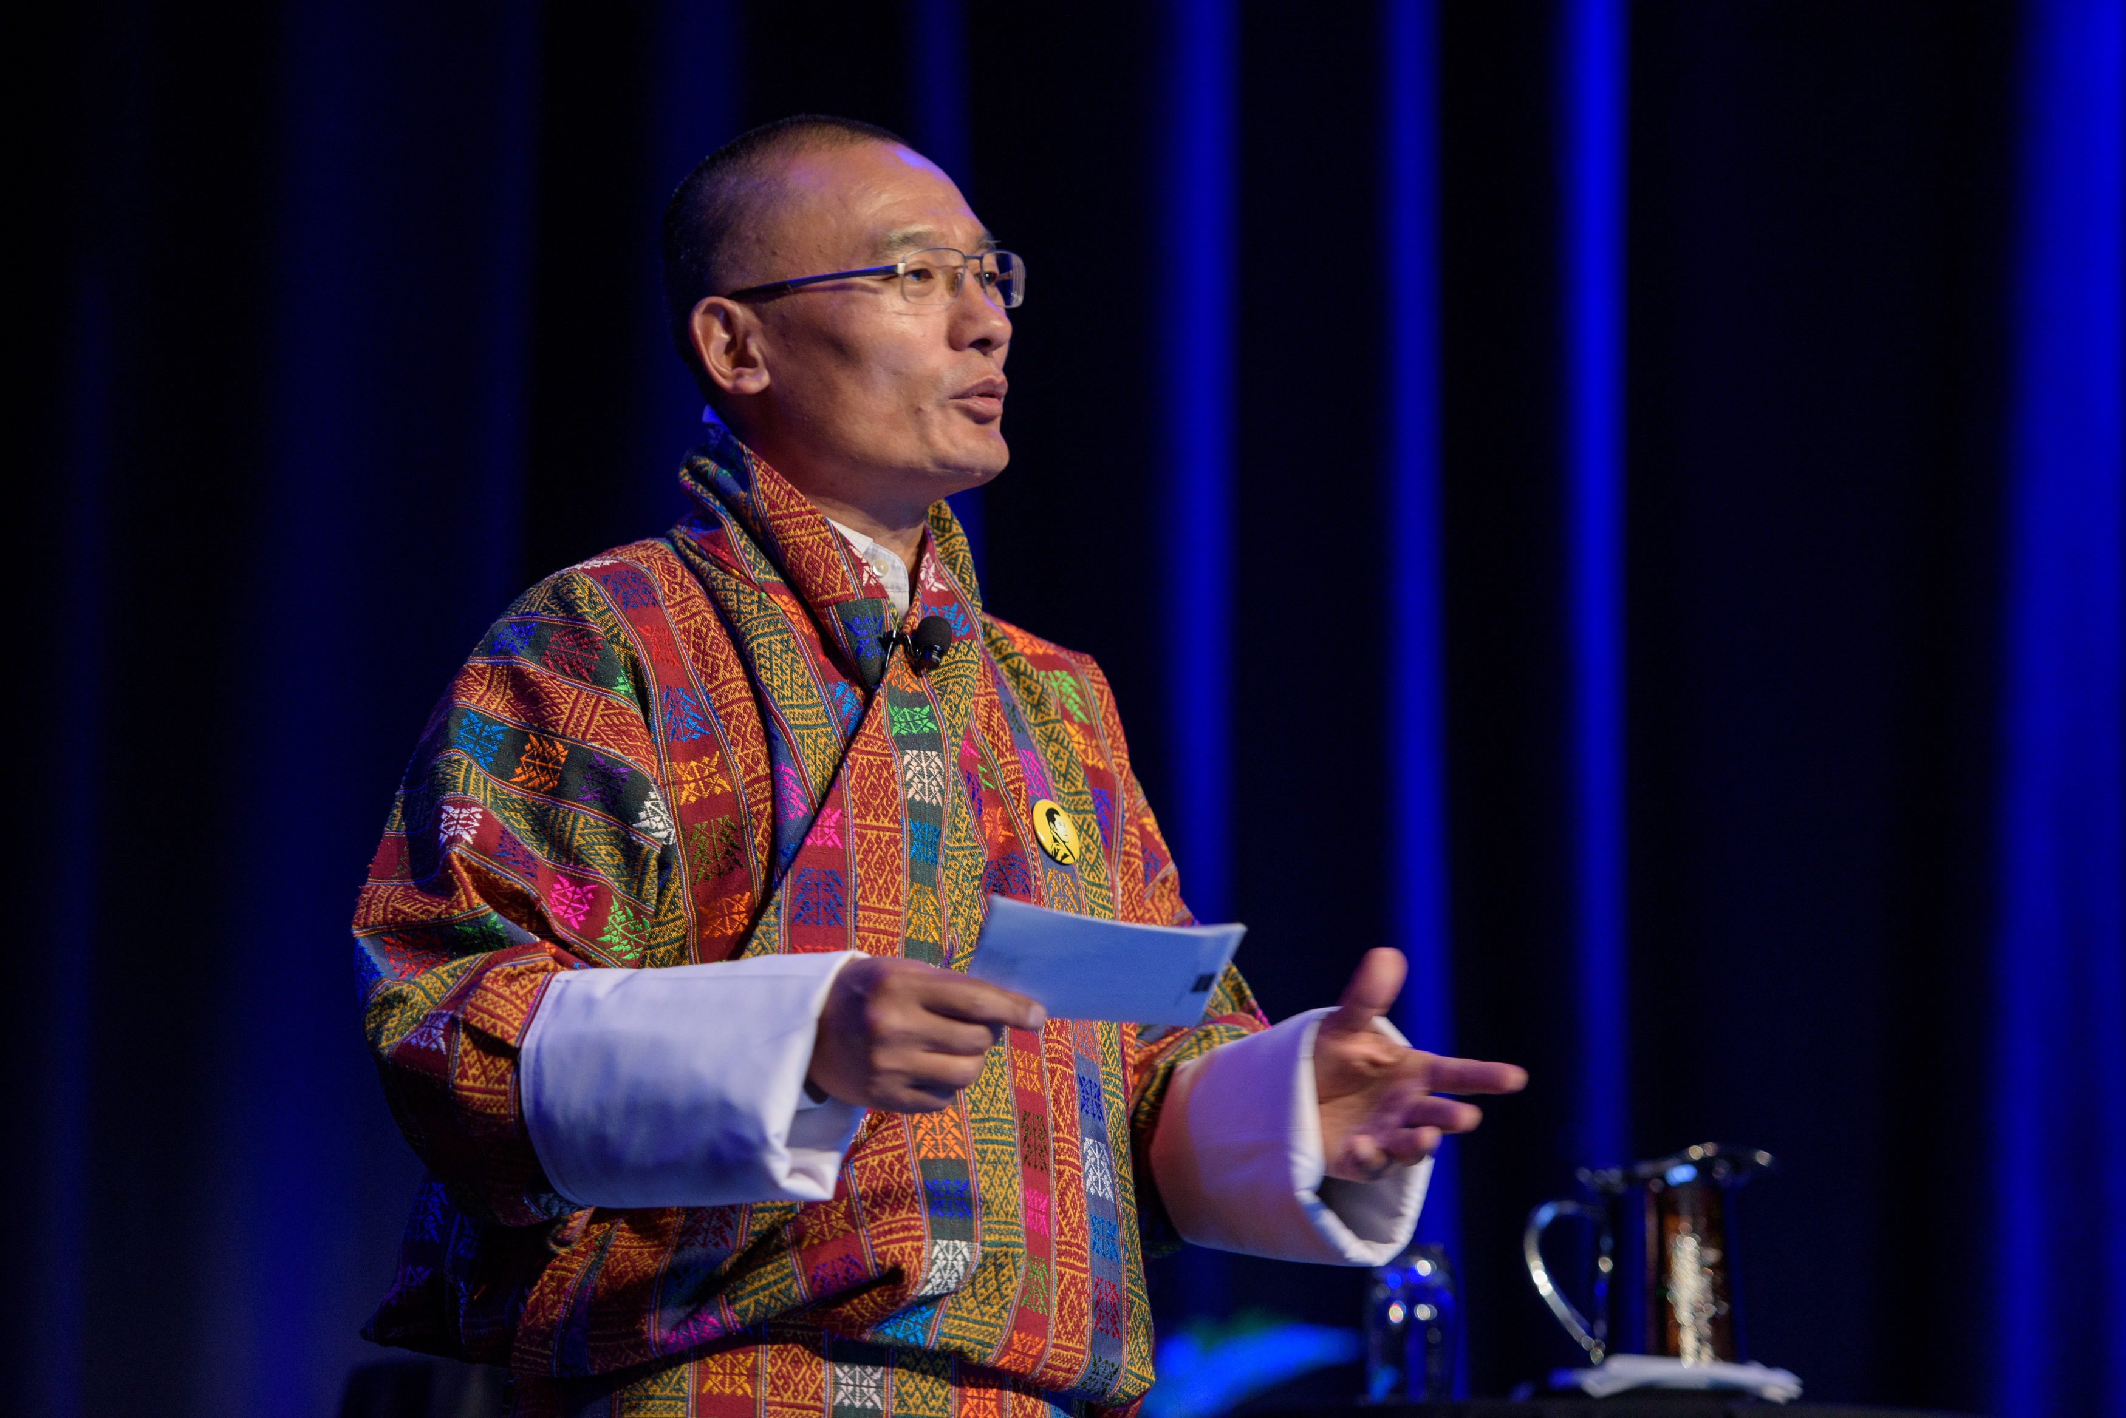
The heroes
Our Members
Our Participants
Notes:
So from Protaganist to Hero. All good stories have some heroes and we are no exception.
For us- our hero are our members and those who support our work even they are not members- these include delegates at events,, speakers at our conferences, authors of our journals.
We knew we had a strong membership base but the slow decline in membership- particularly in our Young Professional Cohort indicated that things needed to change.
We needed to ensure we could leverage the thriving offline community by bringing it online. Allowing professionals from beyond our network to also connect with us, collaborate and ensure that the right solutions were being identified.

Slide 7
The PLOT:
IWA is beyond members only. IWA’s non-member audience is diversifying and growing
World of digital networking is changing fast and continually evolving
We need a way to be able to talk to members and non-members, participants and clients beyond our traditional circles
Notes:
IWA is engaged in the networked society.
It aims to go from strength to strength; continuing the off line (on the ground) and bringing it to the online reality.
The on the ground networking, content sharing, implementing solutions, working best practices must be enabled and facilitated to continues online.
In order for us to be (come) the authoritative voice, and a force to be reckoned with, in the water sector and beyond (including the overall sustainable development agenda), we need to aim to be as strong online as we are off line and to assess and progress both areas simultaneously.

Slide 8
Chapter i: digitalising the iwa EXPERIENCE
Networking
Information Sharing & Content Development
Membership & Journal subscription
INCLUSIVE
INSPIRING
CONVERSION
Notes:
The first chapter of my story focused on building the IWA from within. Creating an avenue through which we could achieve 3 over-riding objectives:
Pillar 1: Inclusivity – through the creation of additional opportunities to Network and Collaborate. To broaden the audience through which we engage with and empower all our members to have a voice not just those in the leadership positions of the IWA.
Pillar 2: Create a hub for inspiration through the sharing of information and development of new content.. To create a place in which members could work outside the traditional structures A space which broke out of silos and allowed for cross-fertalisation between topic areas for enriched learning.
Pillar 3: and finally, a way to drive conversion of members ever deeper into our engagement chain and support such conversion from the outside in, with an online membership application and payment portal which would facilitate payments from our members from all over the world.

Slide 9
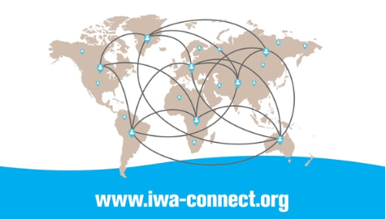
Notes:
The result- IWA Connect which I will introduce briefly to you in this video clip:

Slide 10
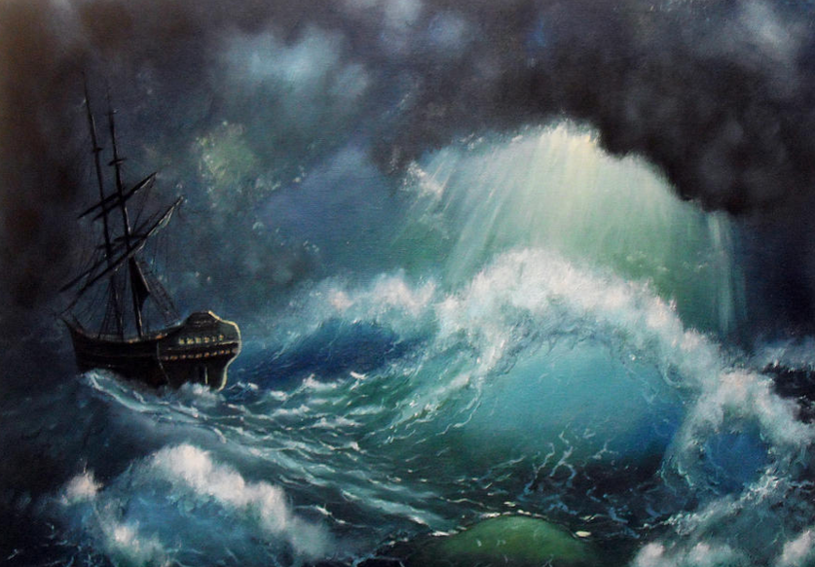
CREATING IWA CONNECT WASN’T PLAIN SAILING!
Notes:
In fact I’m fully open to admit that the last 2 years have been full of pain and lessons learnt!.
Before IWA Connect , came the Online Network Directory- . A rudimentary, clunky, platform, created bespoke to fit the way we worked then. However, chunkiness in look and feel was the least of our problems:
Other problems included: a Membership payment portal not enabling our members to pay online
We were not utilizing the right scope of skills to create and deliver the product we needed and that which we had promised our members.
We were late in delivering the final product to our members.
And as such our members were increasingly disengaging with our drive to change. This change was painful for them as much as for us. The result?
35% drop off in membership in 2015!!!
Lightbulb moment when we started to look at this problem as an opportunity!
We have identified our most loyal supporters. We have a core group of members who are willing t stick it out with us.
Why are the others jumping ship?
Challenge our membership value proposition
Free our minds to conceive of membership in a different way

Slide 11
Engagement Value Cycle: From Collaboration to contribution
Members buy increasingly
more substantial service
packages and, most importantly, they collaborate
with IWA on new solutions
IWA immerses
itself in the world
of our members and
commits to enabling
member success
Members come to depend
on solutions IWA offers,
convinced of value through
Results
Notes:
And ultimately, we realised that membership should be just another station along an engagement progression path, rather than the ultimate destination.
That this is the virtuous circle of Association life.
How can we encourage these individuals to re-engage?

Slide 12
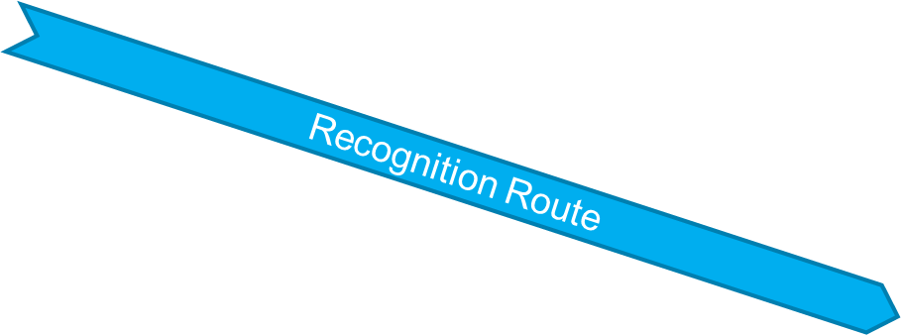
Chapter ii: INNOVATING THE TRADITIONAL MEMBERSHIP MODEL
Ladder of Engagement
IWA Prime Member
IWA Member
IWA Network Member
Monetary Route
IWA Supporter
IWA Prospect
Notes:
And this realisation leads us on to Chapter Two of our story. Innovating the traditional membership model of IWA.
Here we started to emrace the notion that IWA was made up of more than the members we could count on paying us annual membership dues. Our work was supported by the input of 10s of thousands non members. Particiapnts who were engaged in some form or other in the work of the association but who were not being recognited becaue they weren’t members/
Our new membership model evolved the concept of memberhip to include these particiapnts. Creating a multu-tiered engagement path from propsects to supporters, to network members, memebrs and finally prime members- our most loyal and committed members. This move has effextively grown the strength of our netowrk from 100000 to 60000. By including all articpants wihtin our network, the power of the IWA netowrk has expanded, and we have added further muscle to our ambition of becoming the authorative voice for the water sector and beyond to turn to.

Slide 13
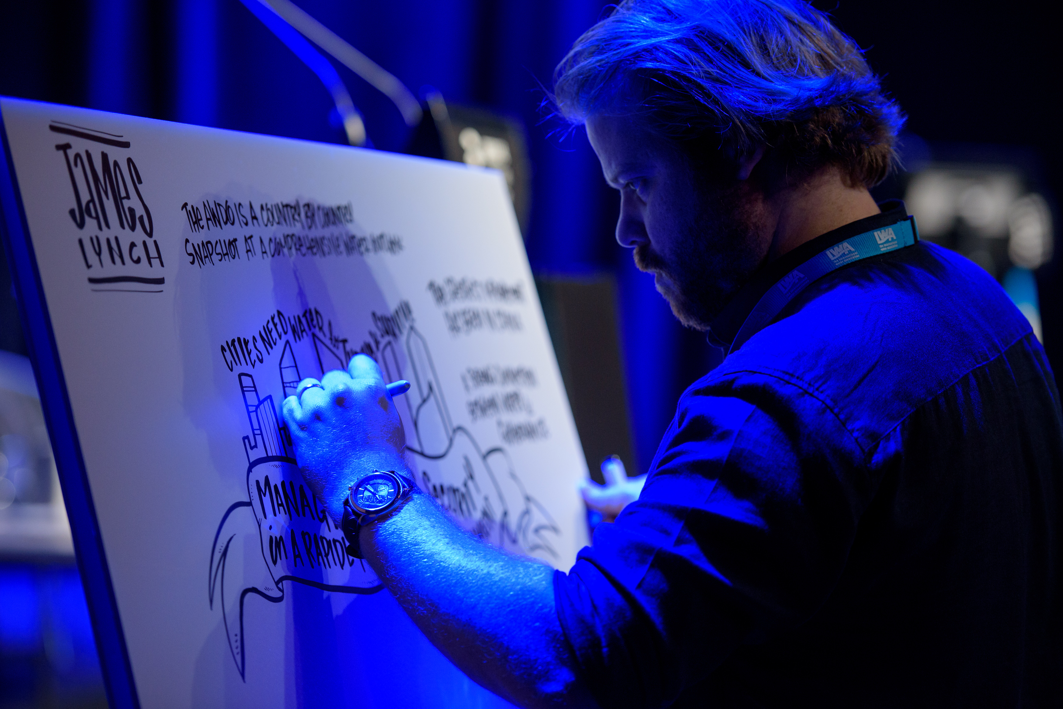
An unfinished story
Notes:
DIVERSIFYING INCOME STREAMS
Advertising
Job board
Donations
There are whole new worlds to explore. Gamification as a new means of collaboration and learning?
Membership Stories – working to rearticulate our value proposition.
Connecting with our members emotionally. Evoking the sense of belonging to drive increased engagement and membership.

Slide 14
THE MORAL OF THE STORY
Lets play to our strengths and leverage strengths of others
Members First. Technology Second.
Notes:
Associations should play to our strengths and leverage the strengths of others: Partnerships & Collaboration
A reality for most Associations are the challenges of resources. We overcame this by seeking to work with external agencies, who would partner with us in our quest to transform our digital landscape. Doing this has ensured that we can remain agile, that we have expanded our expertise skill set at hand and that we can perform on multiple fronts- doing far more than what could be done by 1 or 2 heads.
2. . Members First. Technology Second.
Member Associations don’t have clients. We have members! And we want engaged members. And there lies the real challenge for each digital transformation. How can we focus on the needs of our members? how can we involve them to make the project a success? Digital is not the panacea for associations. Yet without it no organisation will function in the world today. The IWA digital proposition aims to contribute to – and might very well accelerate – the work IWA members do to address global and local water challenges. In order to create impact with this purpose driven IWA journey, we aim to use the full breadth of digital that is at our finger tips. Digital is not about technology, but about member centricity. If you truly want to transform on a digital level, than you must involve them.

Slide 15
Conclusions
Notes:
i) Accepting the status quo is no longer enough.
Be ready to accept that the playing field has changed
Lets be brave and ask the youngest professionals what they would do if they were to create your Association today- How would it look, How would it function? What would their vision be?
And see if this can open the door of change within your association.
ii)Broaden your perspective- so much can be learnt by looking outside of our own industry- what can we learn from the entreuprernial word, the world of start ups?
iii) Be fearless and don’t shut your eyes!.
Risk-averse thinking will hold you back. The nature of an innovative organization is one that thrives on change and embraces honest mistakes
Reward innovation and creativity.
Finally : Dont let the history of your Association become your baggage, your shackles to the Status Quo. Rather let it be your inspiration for continued growth and innovation now and into the future - our future.

