Slide 1
International Associations: Pioneering Roles in Society
Shared values with the UN
UIA Round table
Bangkok
29th September

Slide 2
“Civil society brings vital issues to our attention. They help us make the case for stronger protection of human rights. They push for more equal societies. They mobilize action to address violations and injustice. Their constructive criticism strengthens all that we do. In short, civil society is an indispensable partner of the United Nations.”
UN Secretary-General, Ban Ki-moon at the Human Rights Council Panel on the Protection of Civil Society Space, Geneva, 11 March 2014

Slide 3
Relationship of UN and NGOs

Slide 4
What role do NGOs play in the UN?
Provide expert analysis on issues directly from experience in the field
Serve as an early warning agents
Help monitor and implement international agreements
Help raise public awareness of relavent issues
Play a major role in advancing UN goals and objectives
Contribute essential information
Attend international conferences and events
Make written and oral statements
Network and lobby

Slide 5
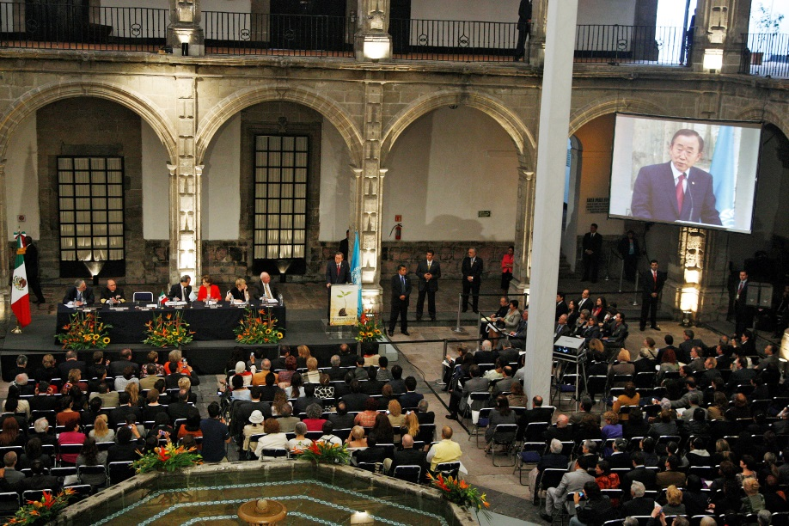
NGO CONFERENCES

Slide 6
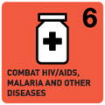
Issues of engagement

Slide 8
MDGs in the Asia-Pacific region
Universal access to primary education
Gender equality in school enrolment
Income poverty more than halved
Trend in infectious diseases reversed
Increased protected areas
Reduction of maternal mortality
Reduction of child mortality

Slide 9
The Unfinished Agenda

Slide 10
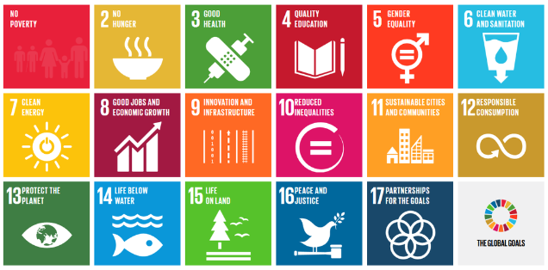
From MDGs to SDGs

Slide 11
From MDGs to SDGs

Slide 12
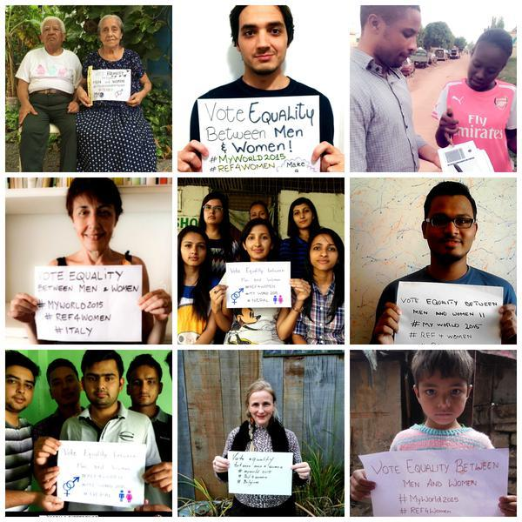
Civil Society in the SDG process

Slide 14
The Economic and Social Commission for Asia and the Pacific

Slide 15
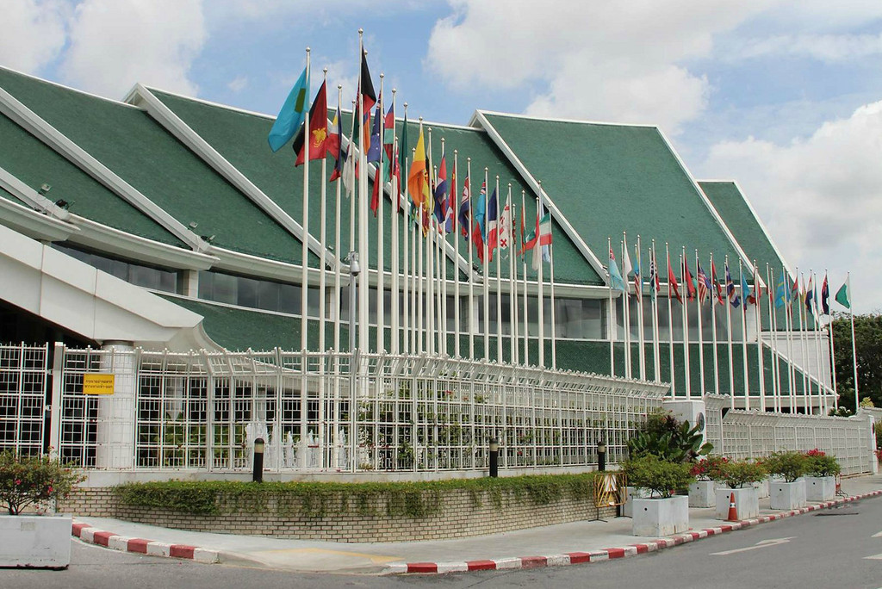
The Economic and Social Commission for Asia and the Pacific

Slide 16
ESCAP and Civil Society

Slide 17
How does Civil Society engage with ESCAP?

Slide 18
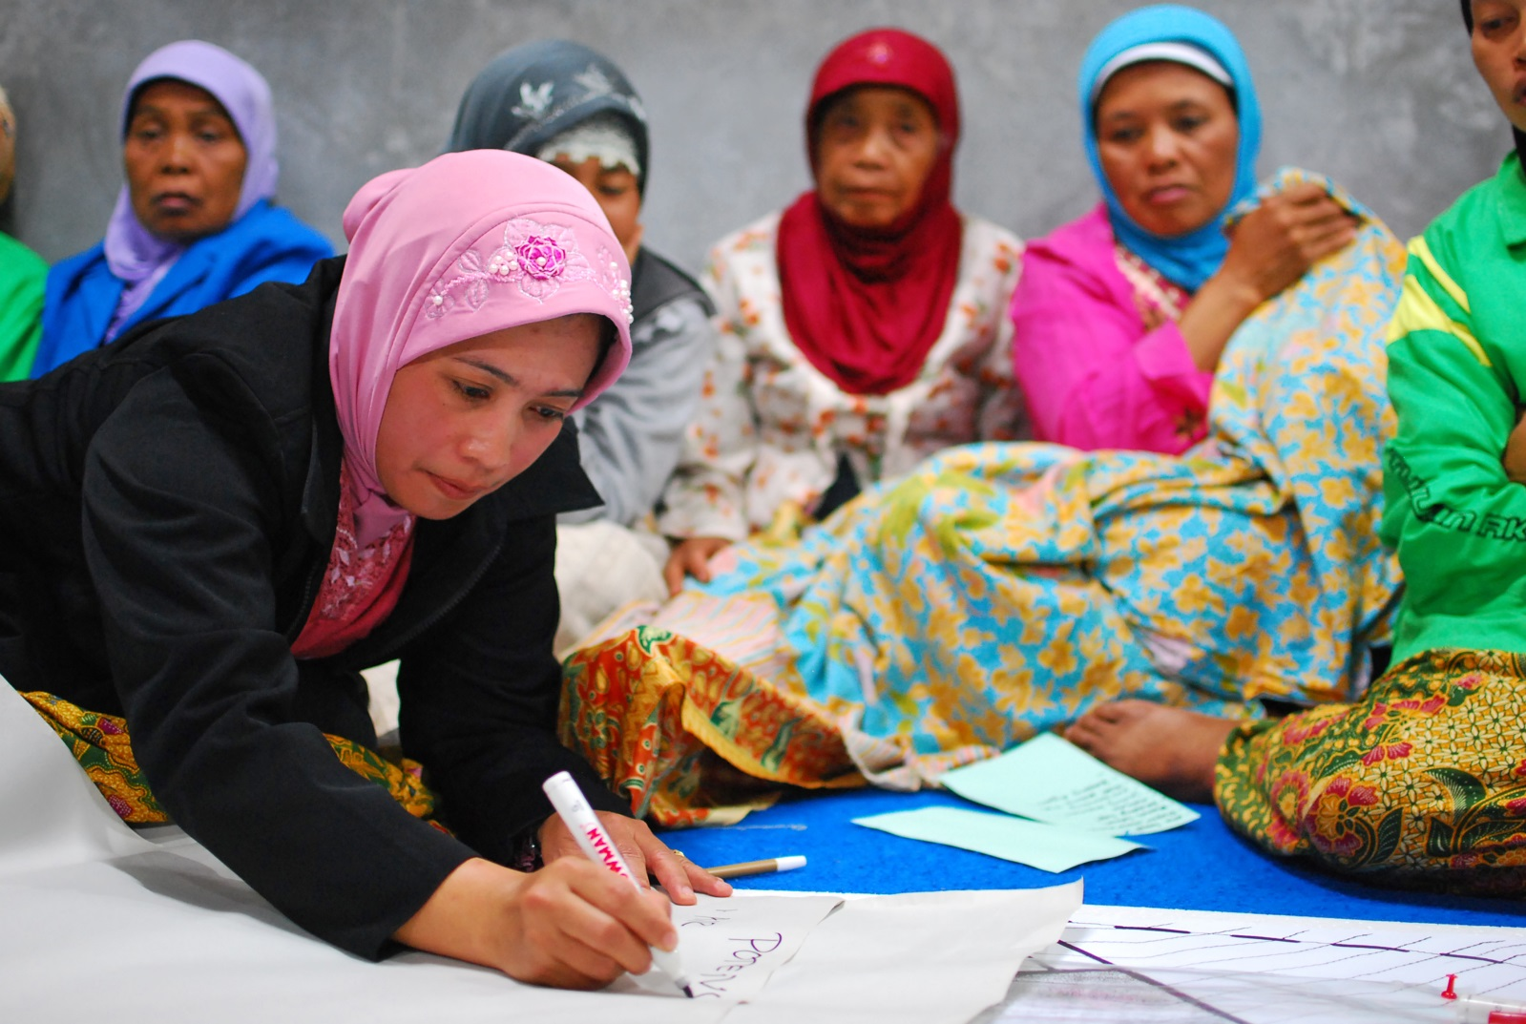
How does Civil Society engange with ESCAP?

Slide 19
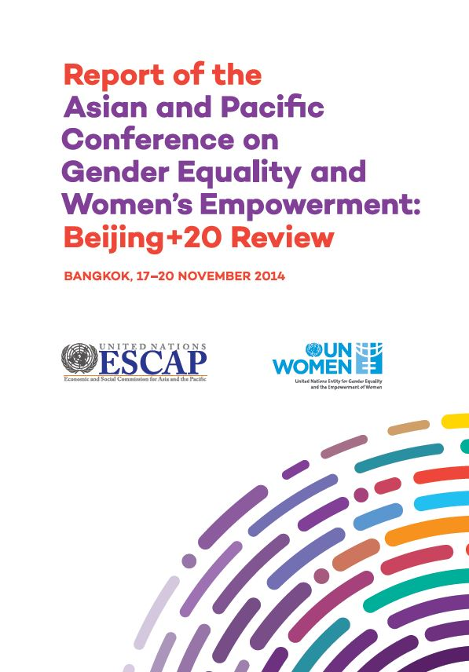
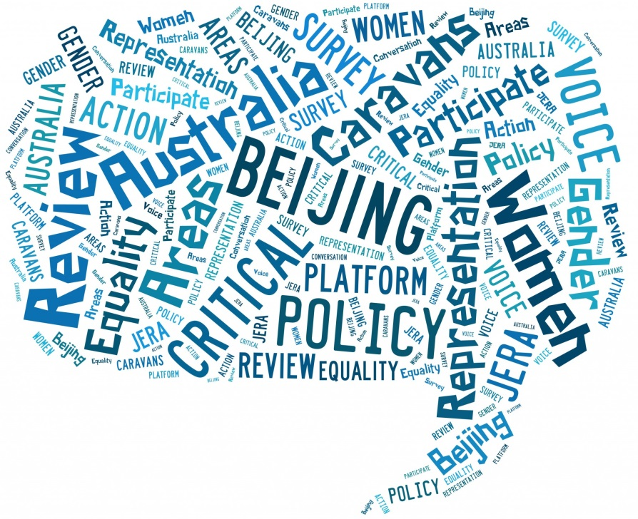
How does Civil Society engage with ESCAP?

Slide 20
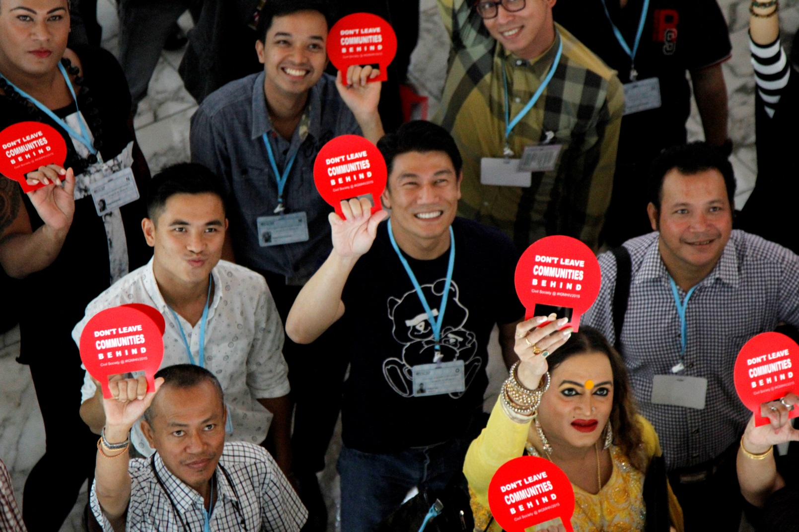
How does Civil Society engage with ESCAP?

Slide 21
How does Civil Society engage with ESCAP?

Slide 22
Training our staff

Slide 23
THANK YOU!
For more information visit:
SDGs
https://sustainabledevelopment.un.org
NGO and UN
http://outreach.un.org/ngorelations
APRCEM
http://www.asiapacificrcem.org/
ESCAP
http://www.unescap.org

