Slide 1
How to End Poverty @ Base of Pyramid
Jack Sim
Founder of
World Toilet Organization
and BOP HUB

Slide 2

Singapore a Poor British Colony: 1960s

Slide 3
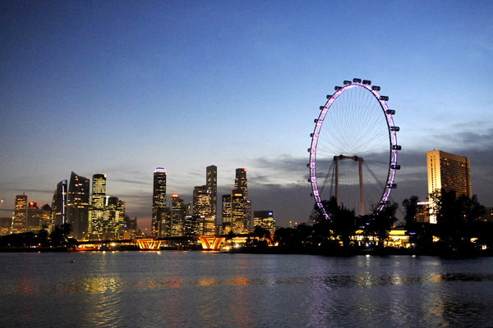
Singapore Today:
World’s 3rd Richest per capita PPP

Slide 4


At 40, 14,600 days to Departure at 80

Slide 5

Time is the Only Currency of Life
Selling Time to Buy Money is a Loss Making Business
Search for Meaning

Slide 6
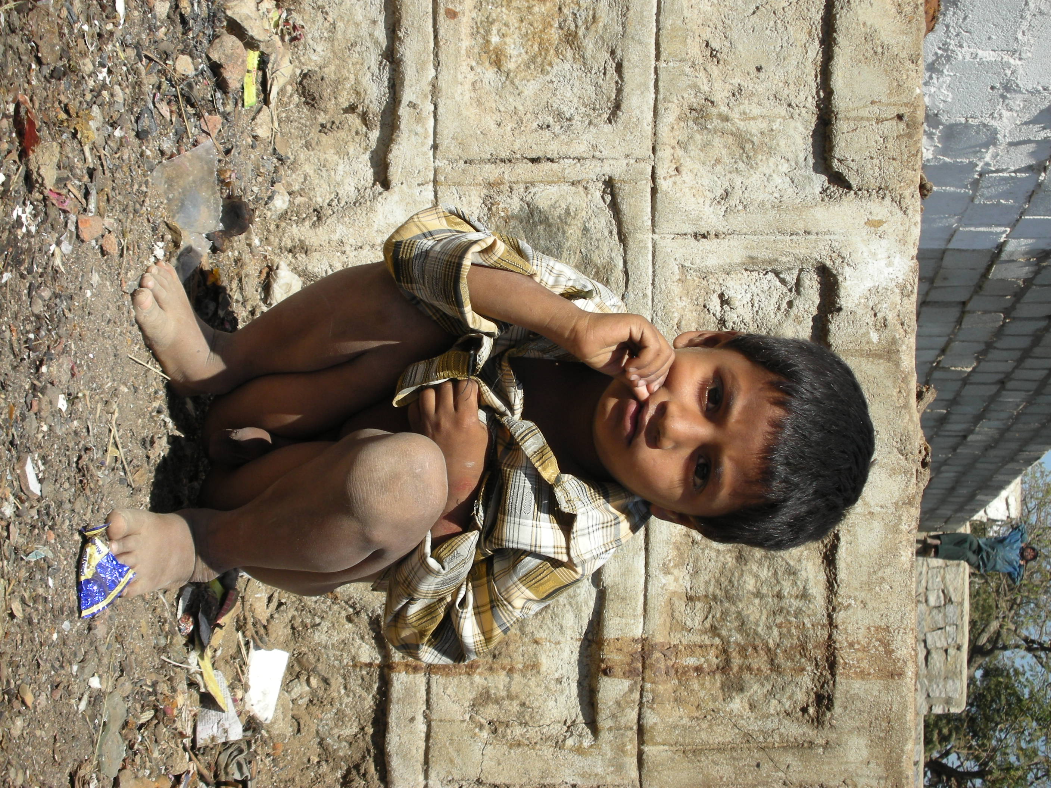
Sanitation an Unserved Needs
2.5 Billions Without Proper Sanitation.
1.5 Millions Diarrhea Death Per Year

Slide 7
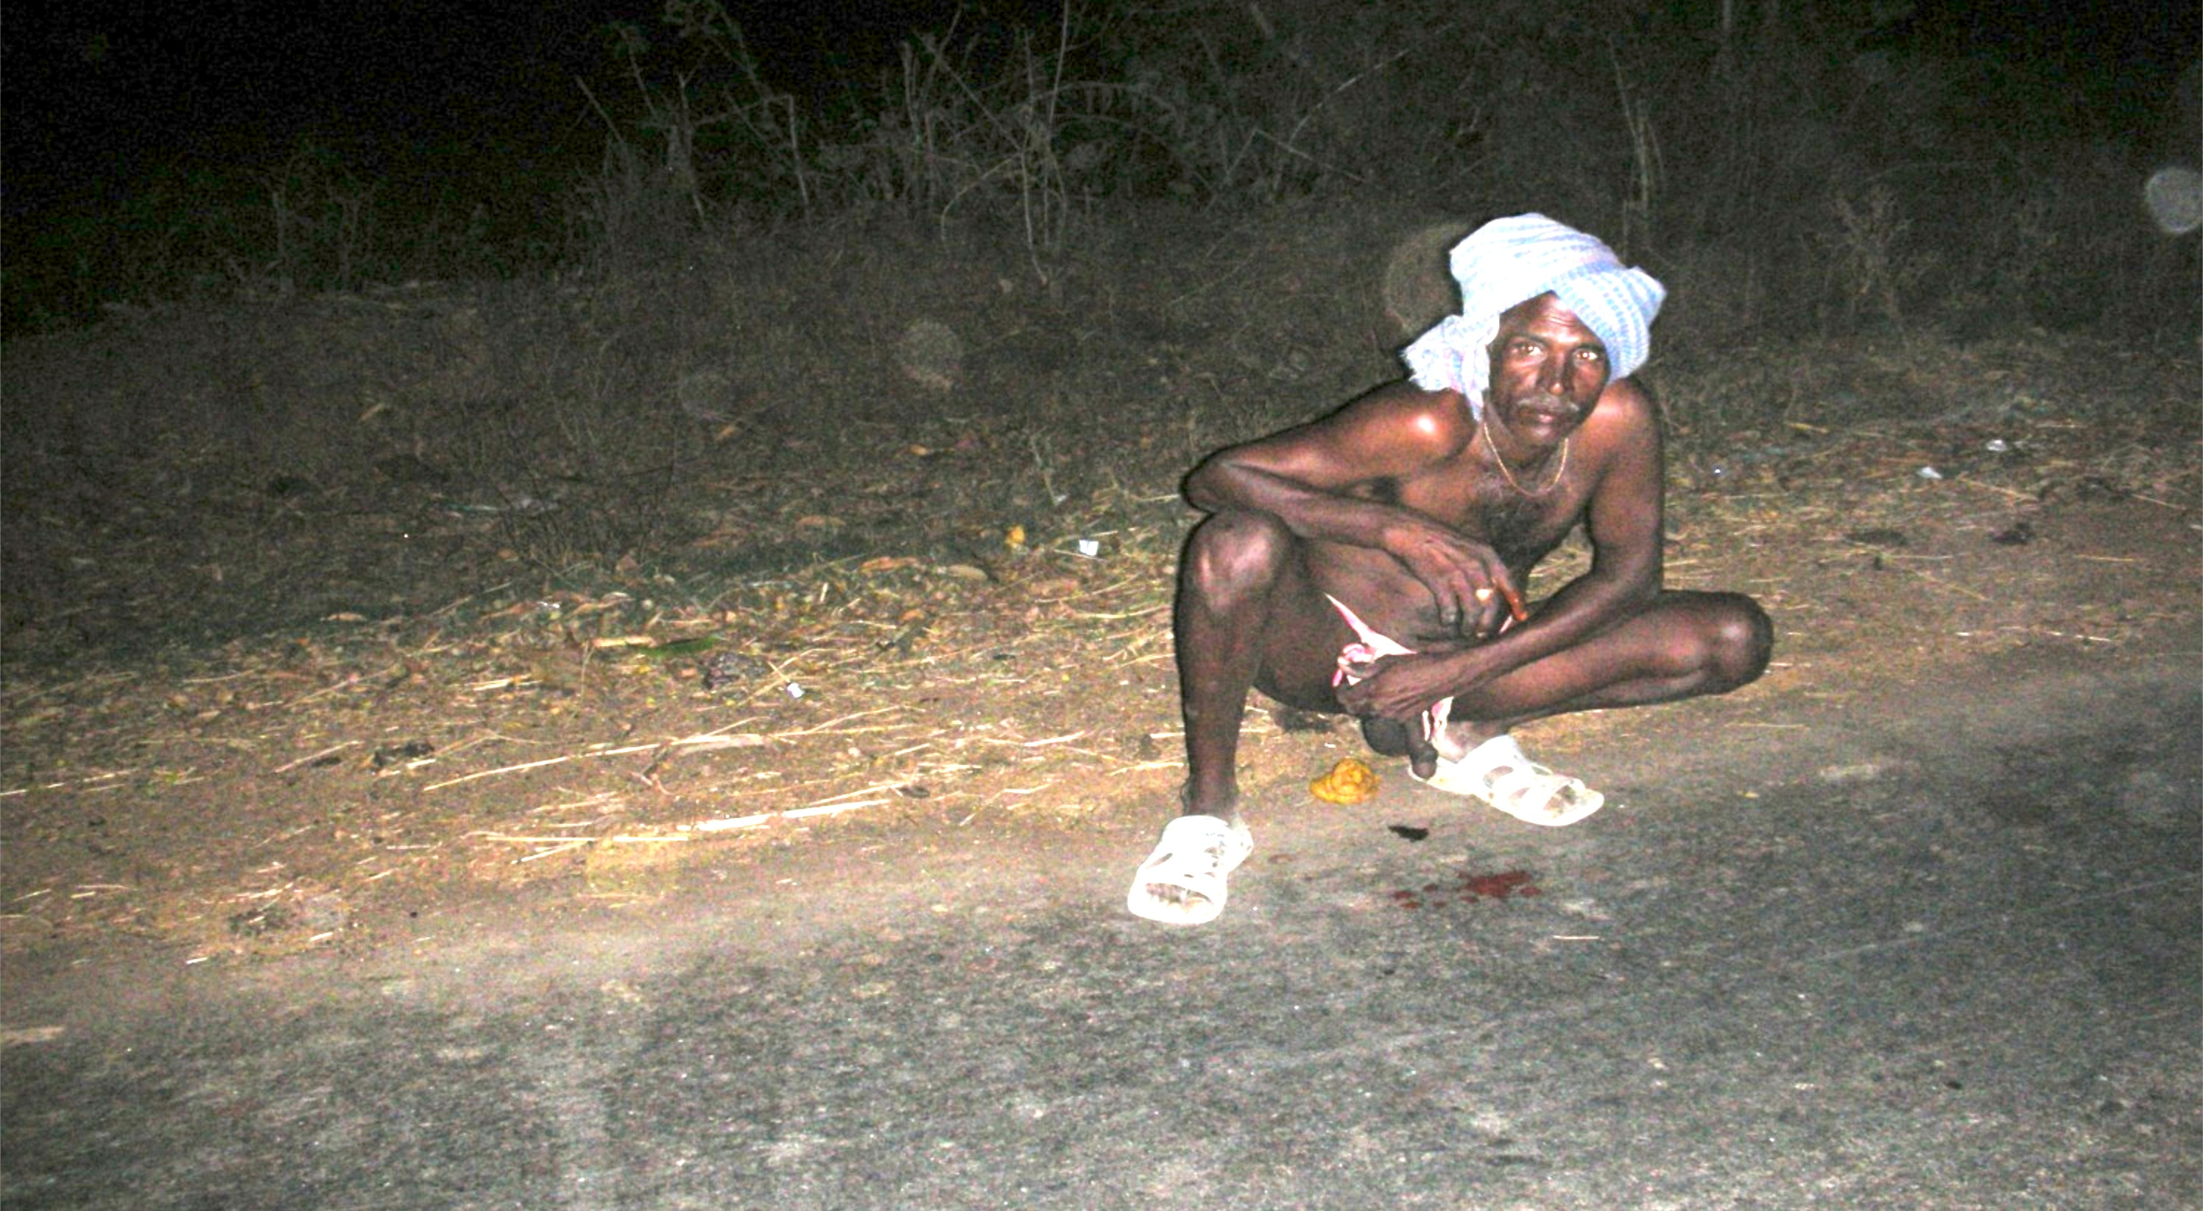

Open Defecations: Dignity in the Dark

Slide 8
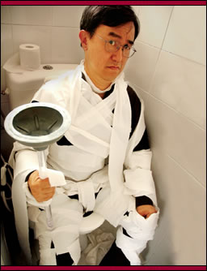
Humor Breaks
Taboo & Starts a Bowel Movement in 19 Nov 2001
NatGeo TV

Slide 9

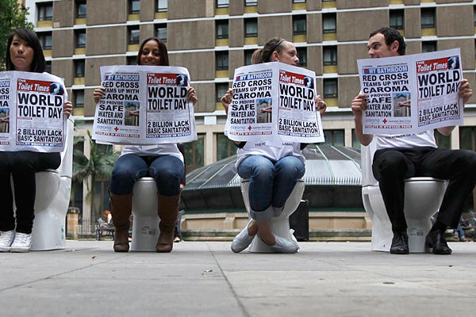
Sydney, Australia
Sydney

Slide 10
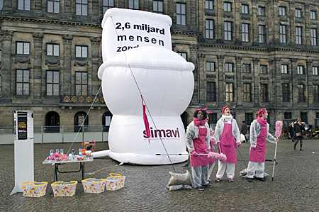
Amsterdam, Holland
Amsterdam

Slide 11
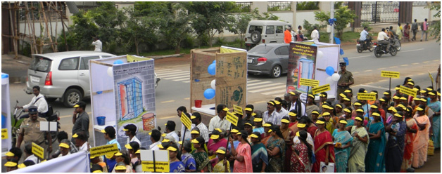
Bangalore, India

Slide 12
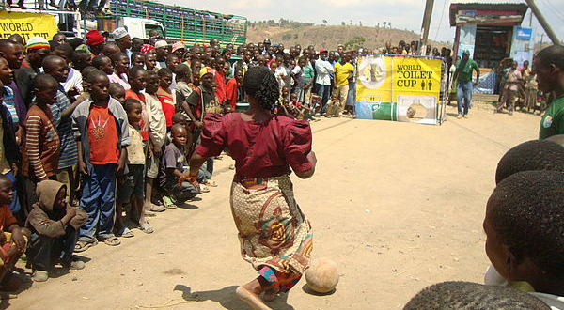
Uganda World Toilet Cup

Slide 13
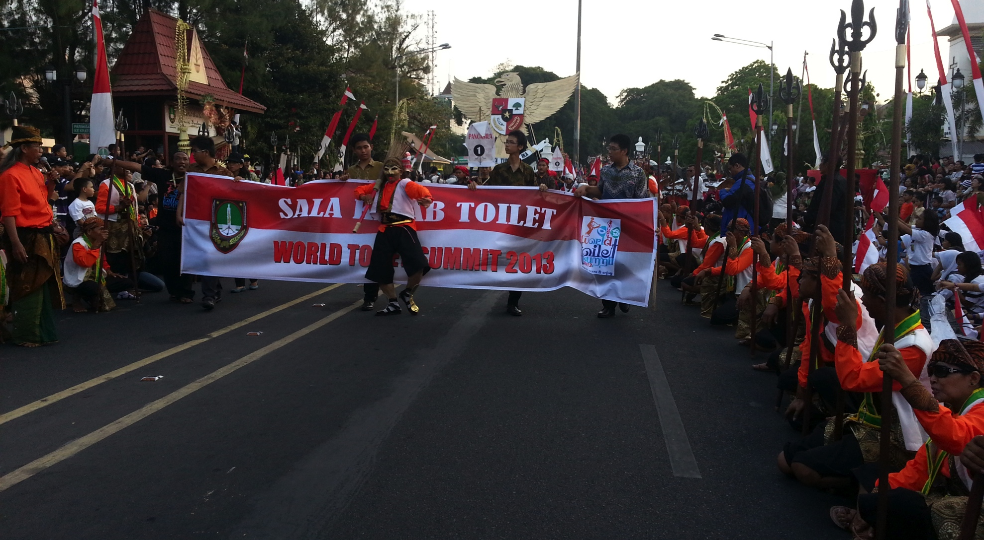
The World Toilet Carnival 2103

Slide 14
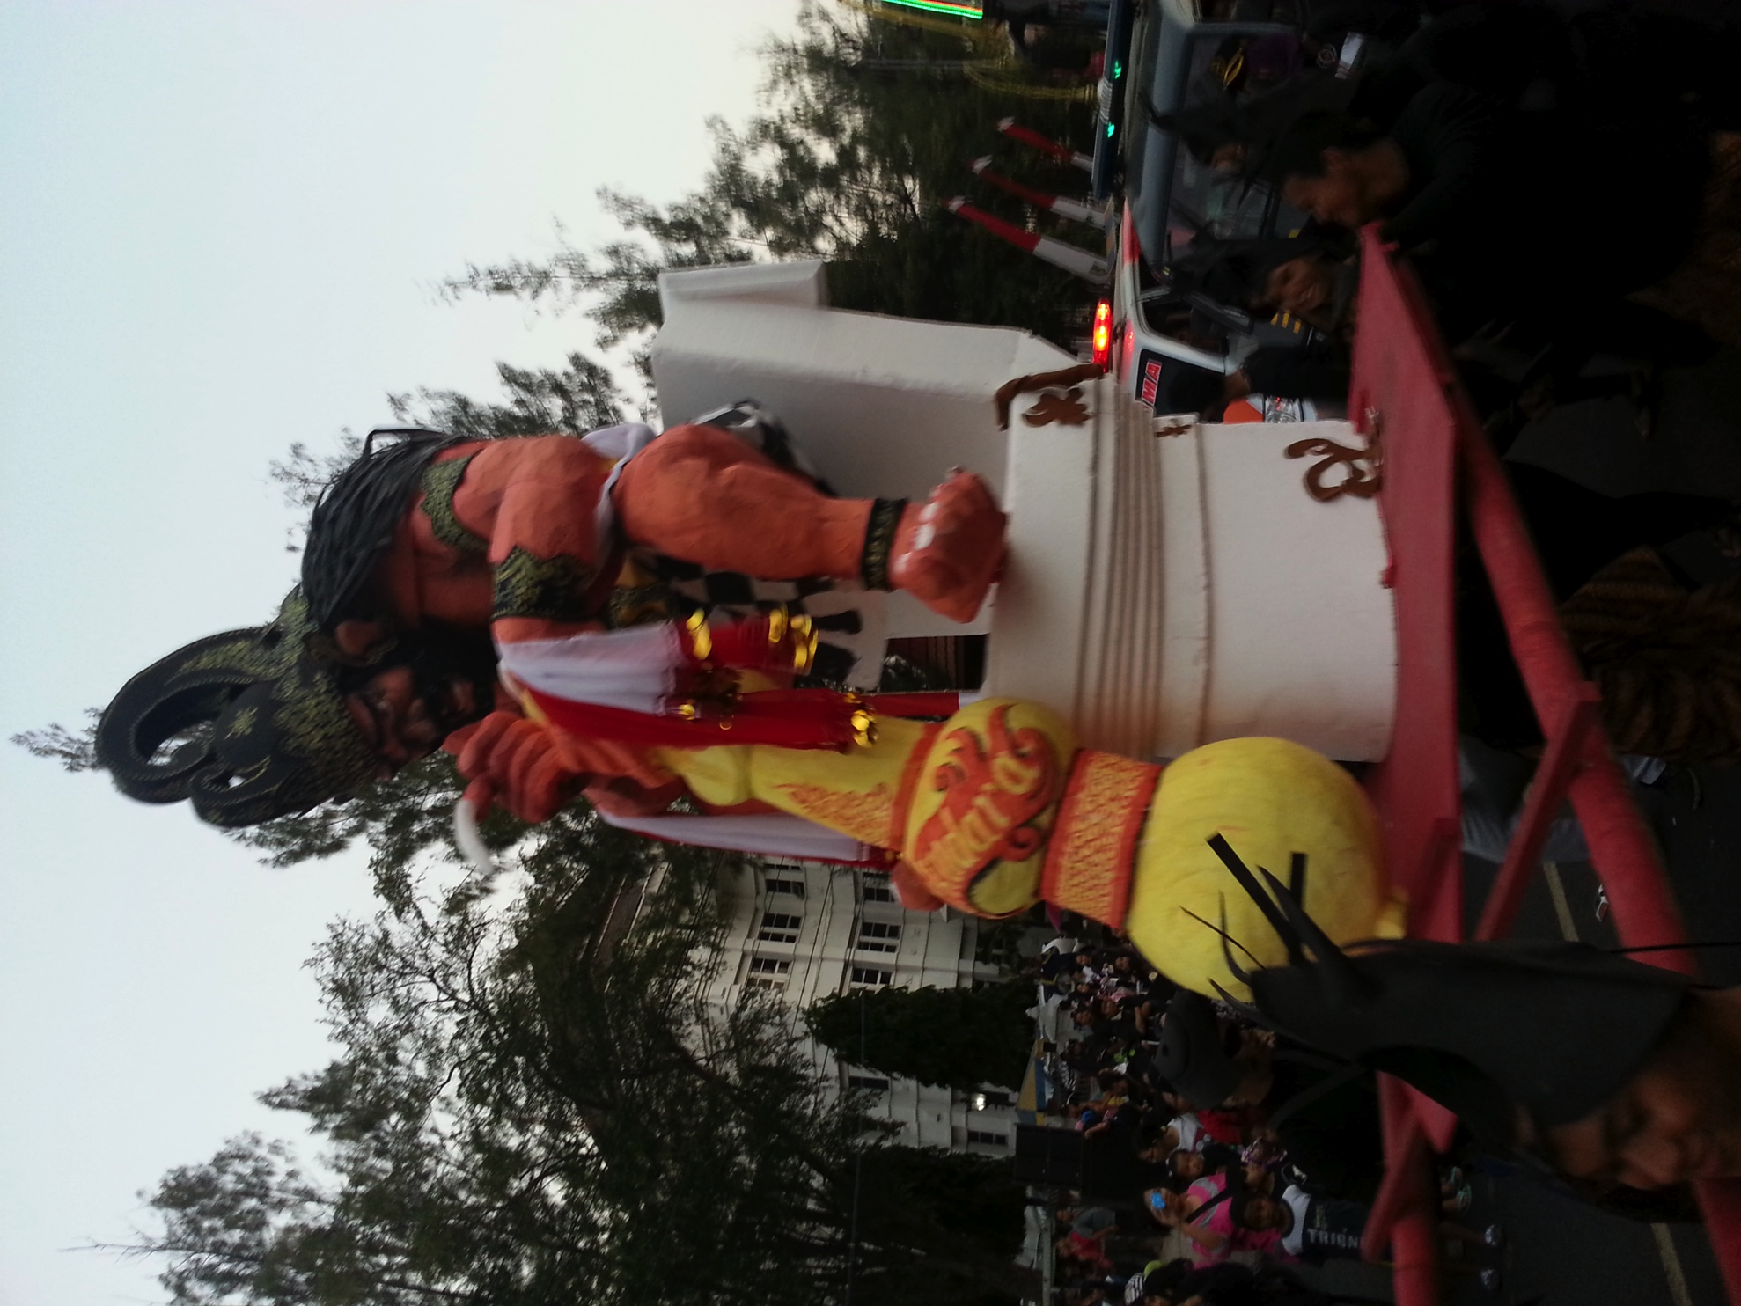
Indonesia Big Toilet Battle

Slide 15

PRINCE OF ORANGE
CHAIR OF UNSGAB

Slide 16
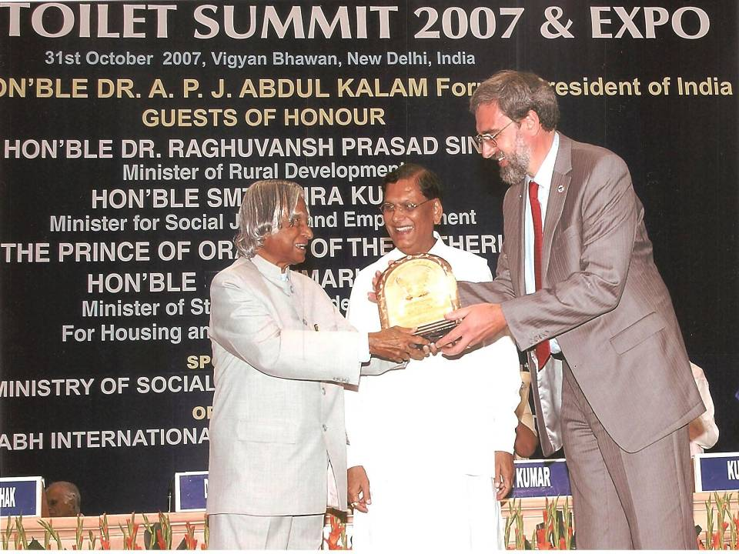
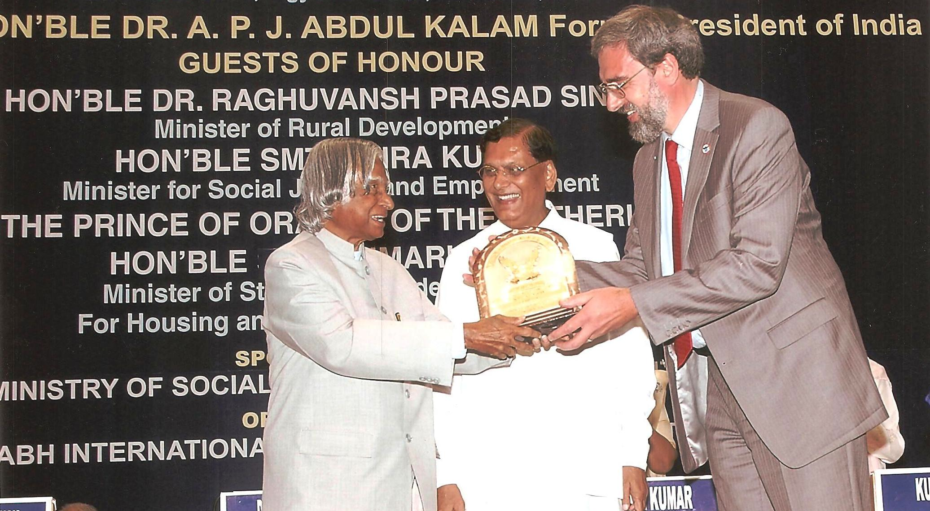

PRESIDENT
OF INDIA

Slide 17


Slide 18
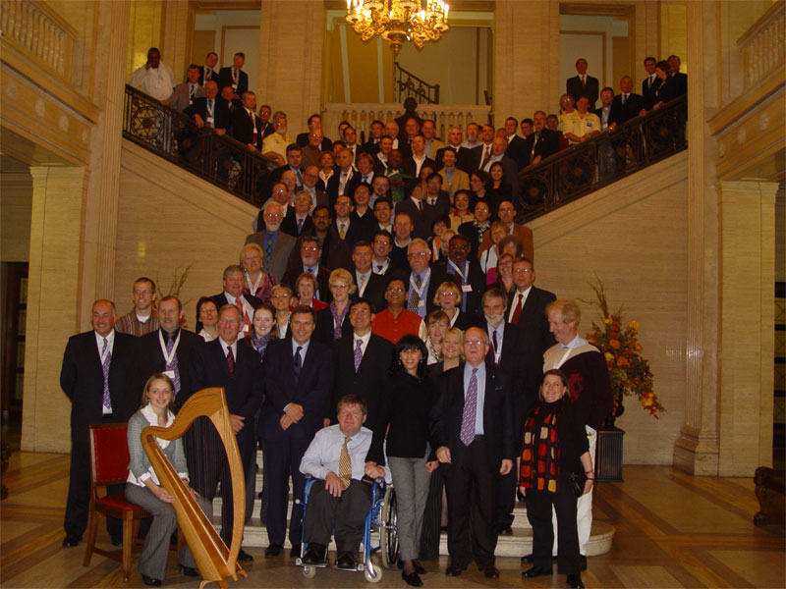
BELFAST, UK: WORLD TOILET SUMMIT 2005

Slide 19
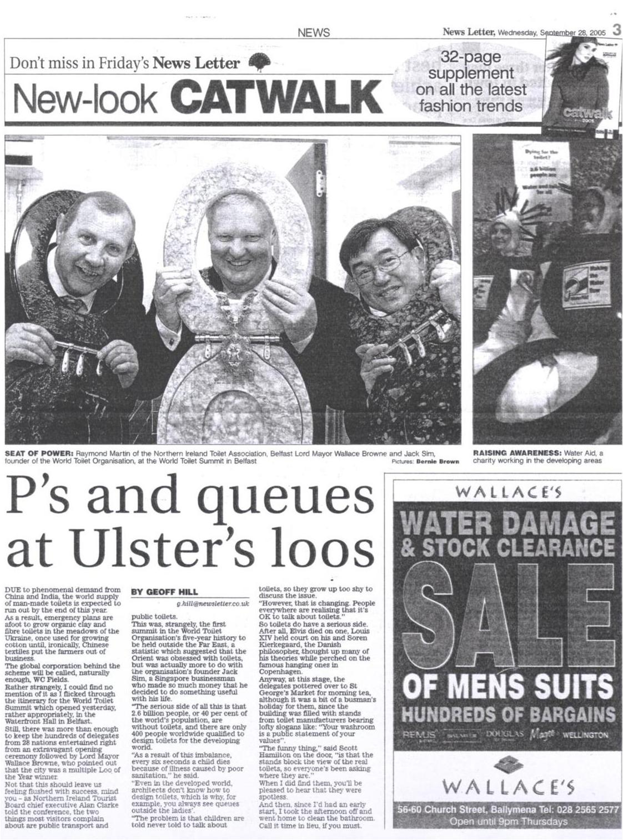
LORD OF THE RINGS

Slide 21
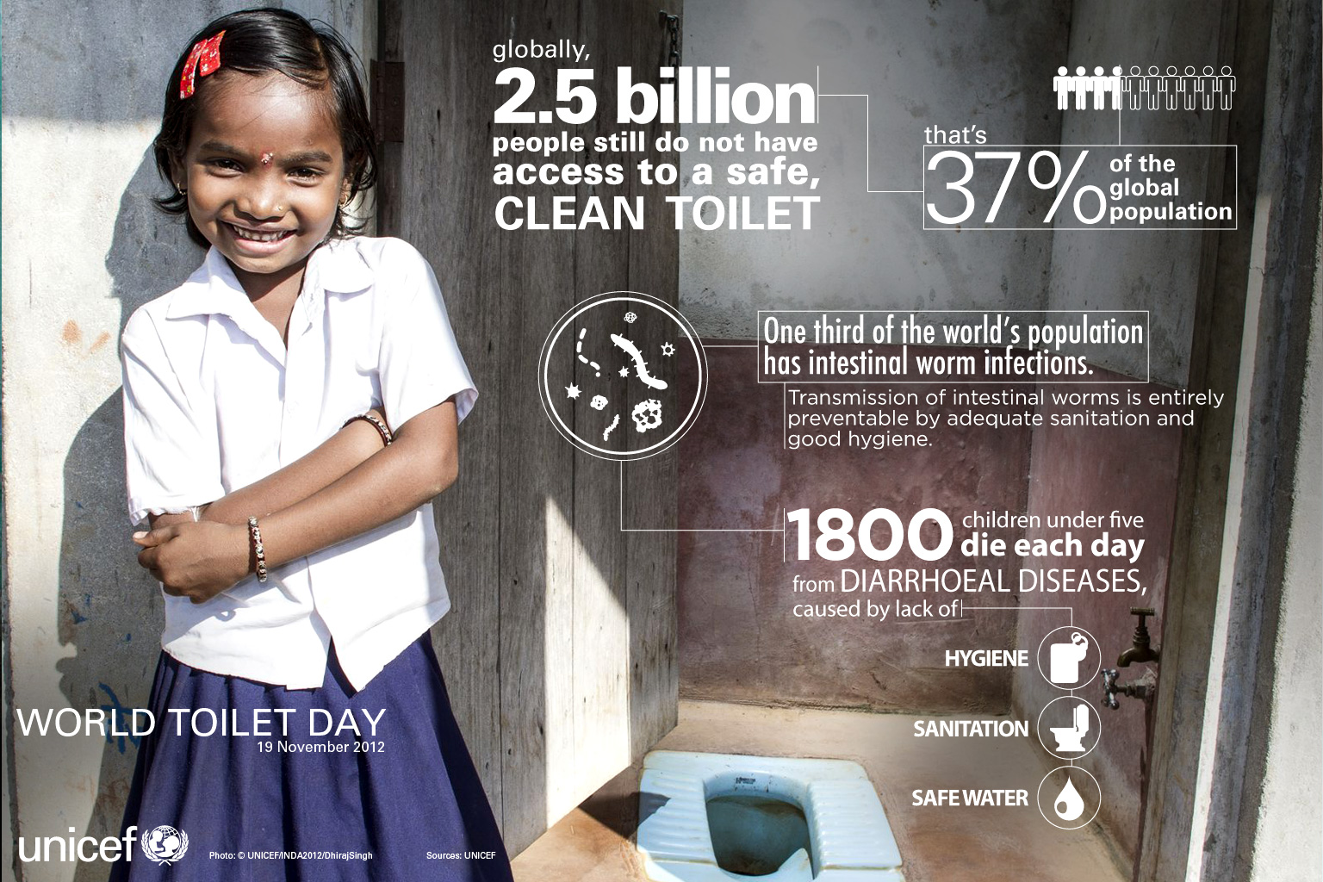

Slide 22

WaterAid

Slide 23
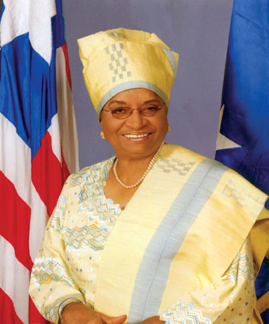
President Sirleaf Johnson of Liberia
“ Live” Broadcast on World Toilet Day

Slide 24
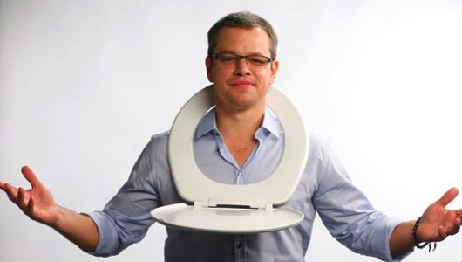
Matt Damon Strike

Slide 25

Bill Gates Reinventiing the Toilet

Slide 26
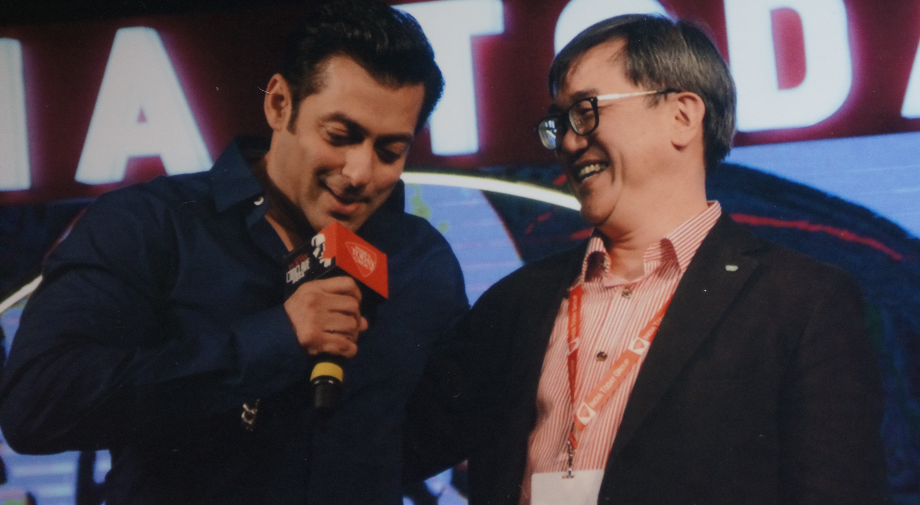
Fund Raising with Salman Khan
‘Live’ National TV India 2014

Slide 27
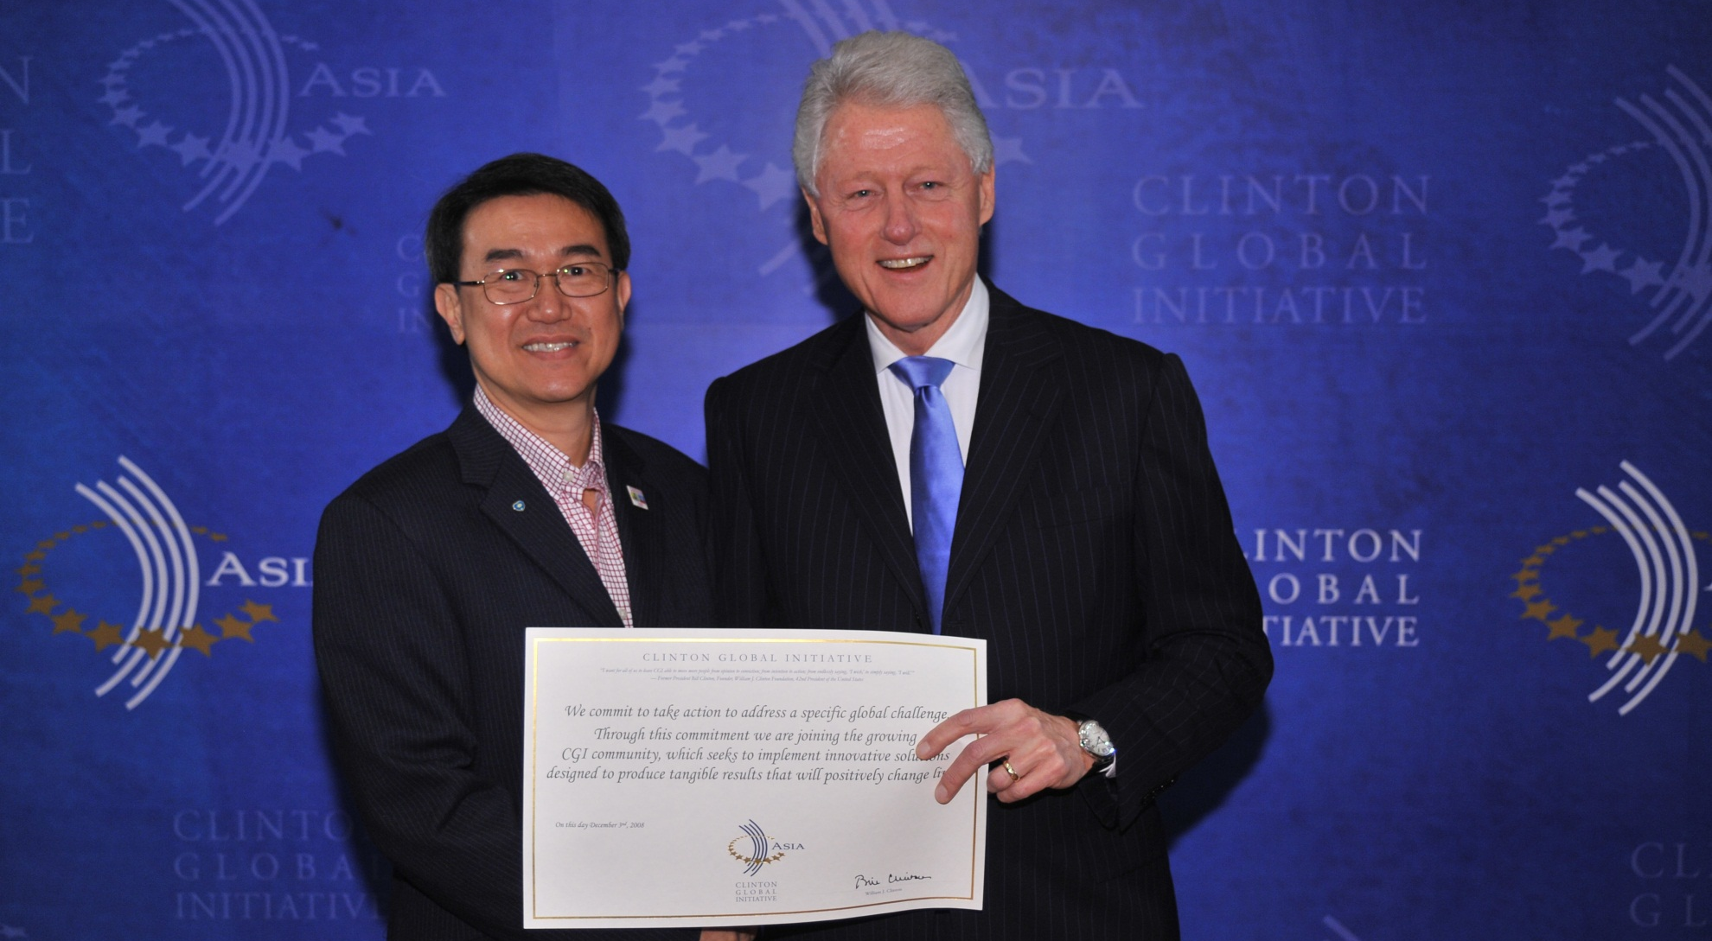
Commitment with President Clinton
President Clinton’s Endorsement

Slide 28
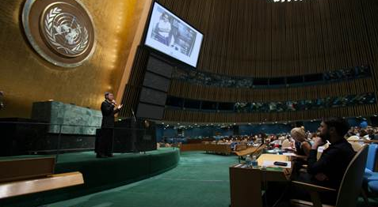
Lobbying at the UN

Slide 29

UNGA declared 19 Nov as Official UN World Toilet Day

Slide 30
Base of the Pyramid Market Potential
1 Billion
> 60 $ a day
Purchase Power
$12.5 Trillion
2 Billion
10-60 $ a day
Fairly urban, extremely competitive, well-served
3 Billion
1-10 $ a day
Fairly rural, under-served, informal economy, inefficient and little competition
$5 Trillion
Base of Pyramid (BoP)
1 Billion
< 1 $ a day
Humanitarian

Slide 31
A brave new BoP market place:
The Opportunity
4 Billion New Customers
Timing is Perfect
Trend is Growing
Success Models Exist
Human Capital Willing
Funds Follow Opportunities
Notes:
Many players are trying to serve the BoP but different interests and uncoordinated efforts leads to an inefficient use of resources

Slide 32



















The Challenge: Dysfunctional, Distorted, Fragmented
Foundations
  Interests: Social development, innovation, population sensibilization and emergency management
  Resources: Capital, management, business planning, human resources
UN Group
  Interests: Economic and social development, meeting the MDG KPI, safeguarding peace and human right, etc.
  Resources: Capital, human resources
MNCs & SMEs
Social entrepreneurs
Others
NGOs
  Interests: Emergency management, providing primary goods and services, safeguarding human rights, etc.
  Resources: Human resources, technology
  Interests: Entering new markets and image recognition (CSR)
  Resources: Capital, technology and human resources
  Interests: Profit and social development
  Resources: Geographic knowledge/ proximity, human resouces
  Interests: Profit, innovation, economic and social development, research, poverty reduction, etc.
  Resources: Human resouces, management, knowledge, technology, etc.
Governments
  Interests: Social and economic development, employment, political stability, emergency management, etc.
  Resources: Capital, policy making, human resources, infrastructure
Development banks
  Interests: Economic and social develo-pment, meeting MDG KPI, etc.
  Resources: Capital and investment analysis

Slide 33
Most Good Models Remains Island Solutions
Uncoordinated efforts leads to an inefficient use of resources
There is Great Profit in Cutting Waste

Slide 34
Leveraging on each other’s existing assets to create a vibrant ecosystem
Goverments
Foundations
Social Entrepreneurs
NGOs
MNCs & SMEs
International Forums
Development banks
UN Groups
Universities
Notes:
Gears come in machine part
We want to put in the gears and grease to get the development machine running

Slide 35
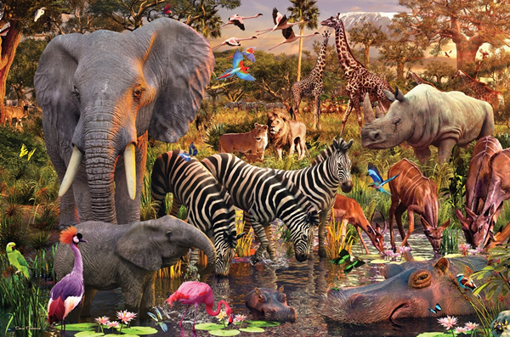
Build An Ecosystem: Respect that Every Specie has a Role
No Winner or No Losers. When Everyone is Needed: Zero Waste
35

Slide 36
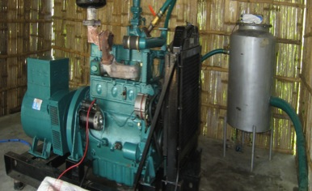
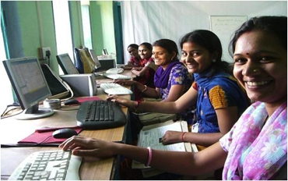
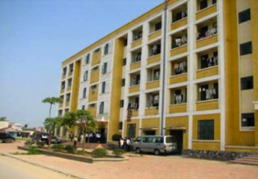

What can Market-Based Solutions deliver for the poor?
B2R Technologies
Husk Power Systems

Slide 37
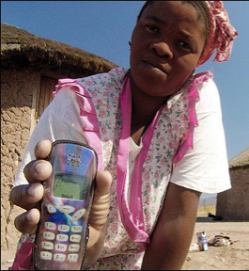
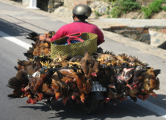



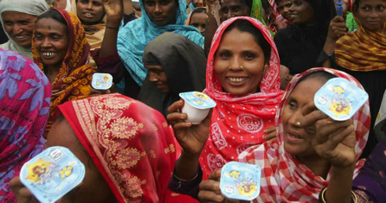
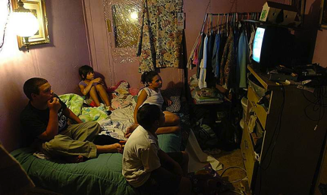


Who are providing the Market-Based Solutions for the poor?

Slide 38


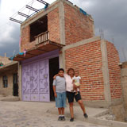

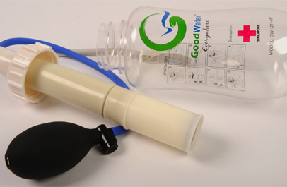
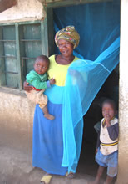

Current Market-Based Solution providers for the poor?

Slide 39

Logistics and transportation

Slide 40
SaniShop Micro-Franchise
The Poor As Entrepreneurs | Creating Jobs | Affordability & Access

Slide 41
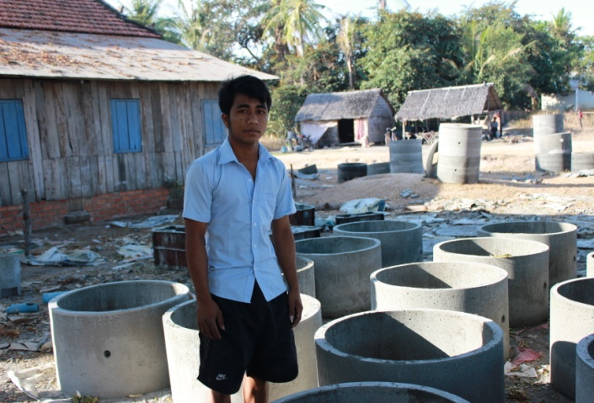
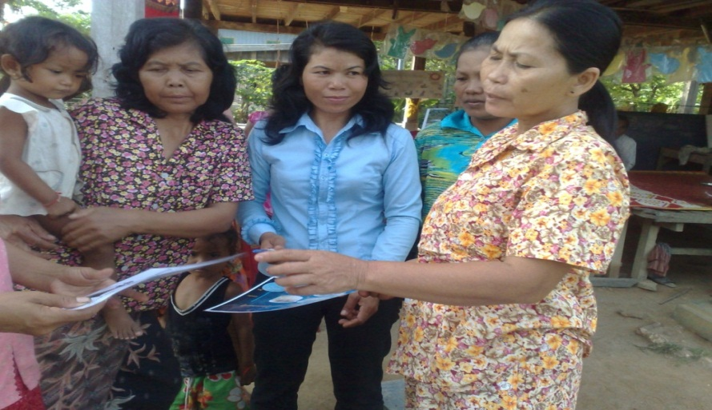
Sanishop in Cambodia
Train Local Manufacturer
Components: Locally welded steel molds based on IDEO design, cement, sand, gravel and water
Small family enterprise.
Economic Empowerment Process
SaniShop established Cambodia 2010
Flexible payment mechanism
Commission-based sales agents
Simple, effective marketing tools
SaniShop in Mozambique, India

Slide 42

Grow models to scale like fractals
What are the missing links?

Slide 43
BoP HUB Integrated Delivery: Cheaper. Faster. Better. Easier
Scale innovations through leveraging partnerships
Cut Waste in Money, Time, Design, Technology, Tools, Procurement, Distribution, Consultancies, Monitoring & Evaluation
Complete Supply Chain Management
Turn ODA and Charity Models into Business Models

Slide 44
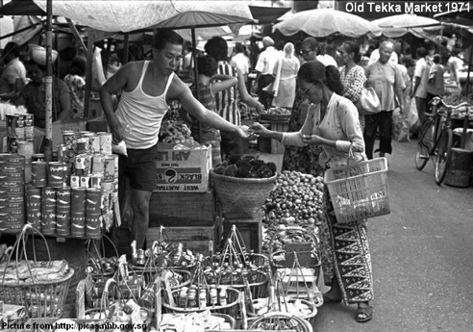
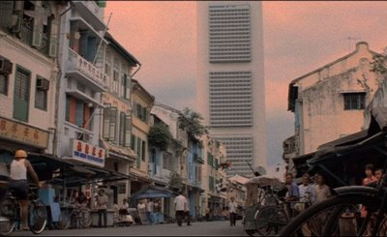
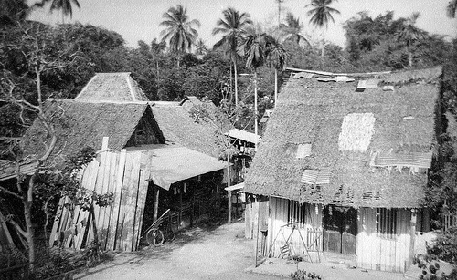
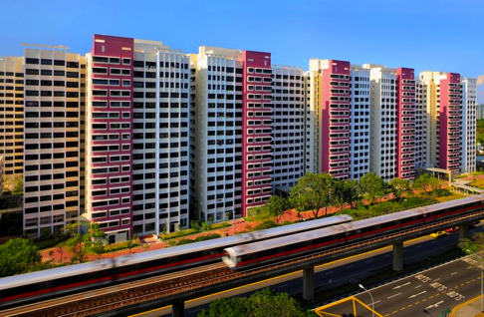
The Singapore BOP Story…
“Teach a Man to Fish. Nothing is For Free”
From Third World to First World in 25 Years.
Investment, Vocational Training, Jobs, Housing, Health, Education and Rule of Law.

Slide 45
BoP Hub Integrated Delivery Services
Shared Services Center
Faster Easier
CheaperBetter: Lower Waste,
Higher Impact
BOP World Convention & Expo
+
BOP Design Center
Accelerator
+
+
=
Cross-sectors collaboration for Synergy
Back-Office Support
Collaborative Design Globally
Industrial Fair

Slide 46
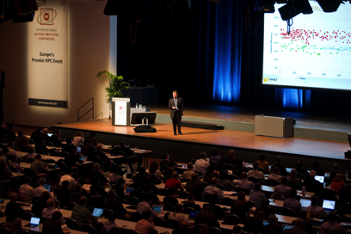
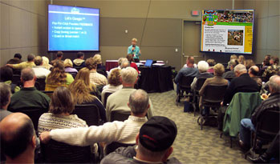
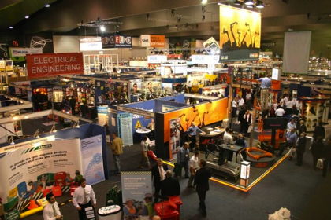
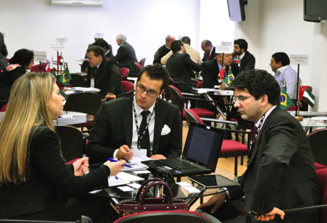
BoP World Trade Convention
Plenaries
Workshops
Tradeshow
Partnerships
Discussions

Slide 47
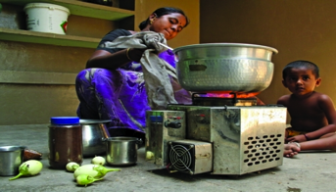
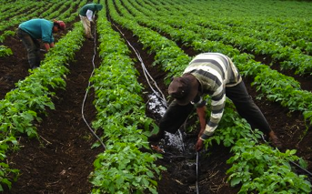
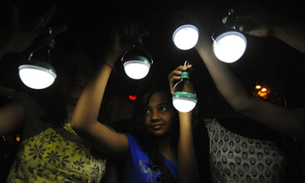
Toilets
Cooking Stoves
Drip irrigation
Lights

Slide 48
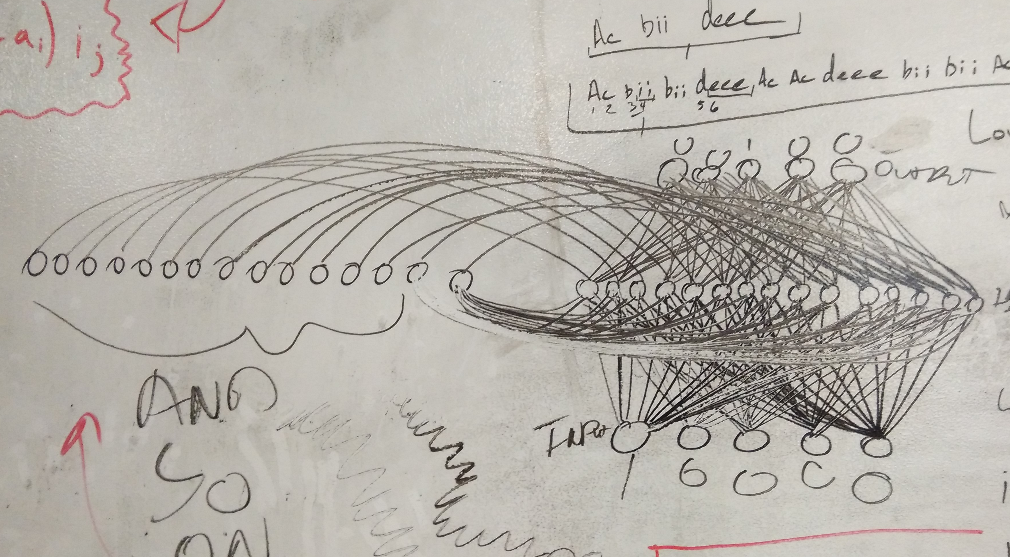
Accelerator: Connecting Multiple Nodes Synergy
48

Slide 49

Coordinating Services Demand to Supply

Slide 50
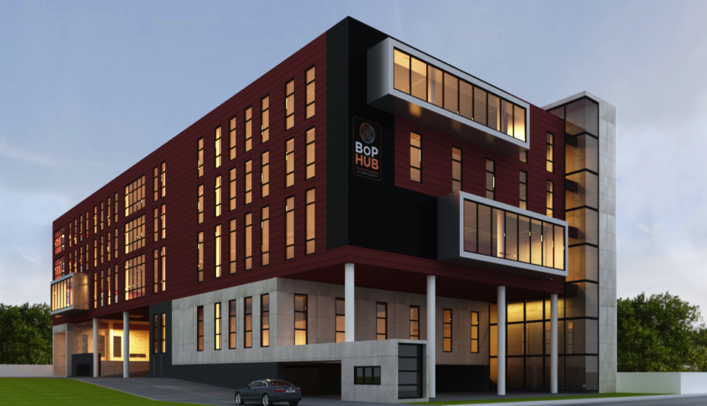
BOP HUB Design Center 65,000 sq ft
Co-Working Space & Collaboration

Slide 51
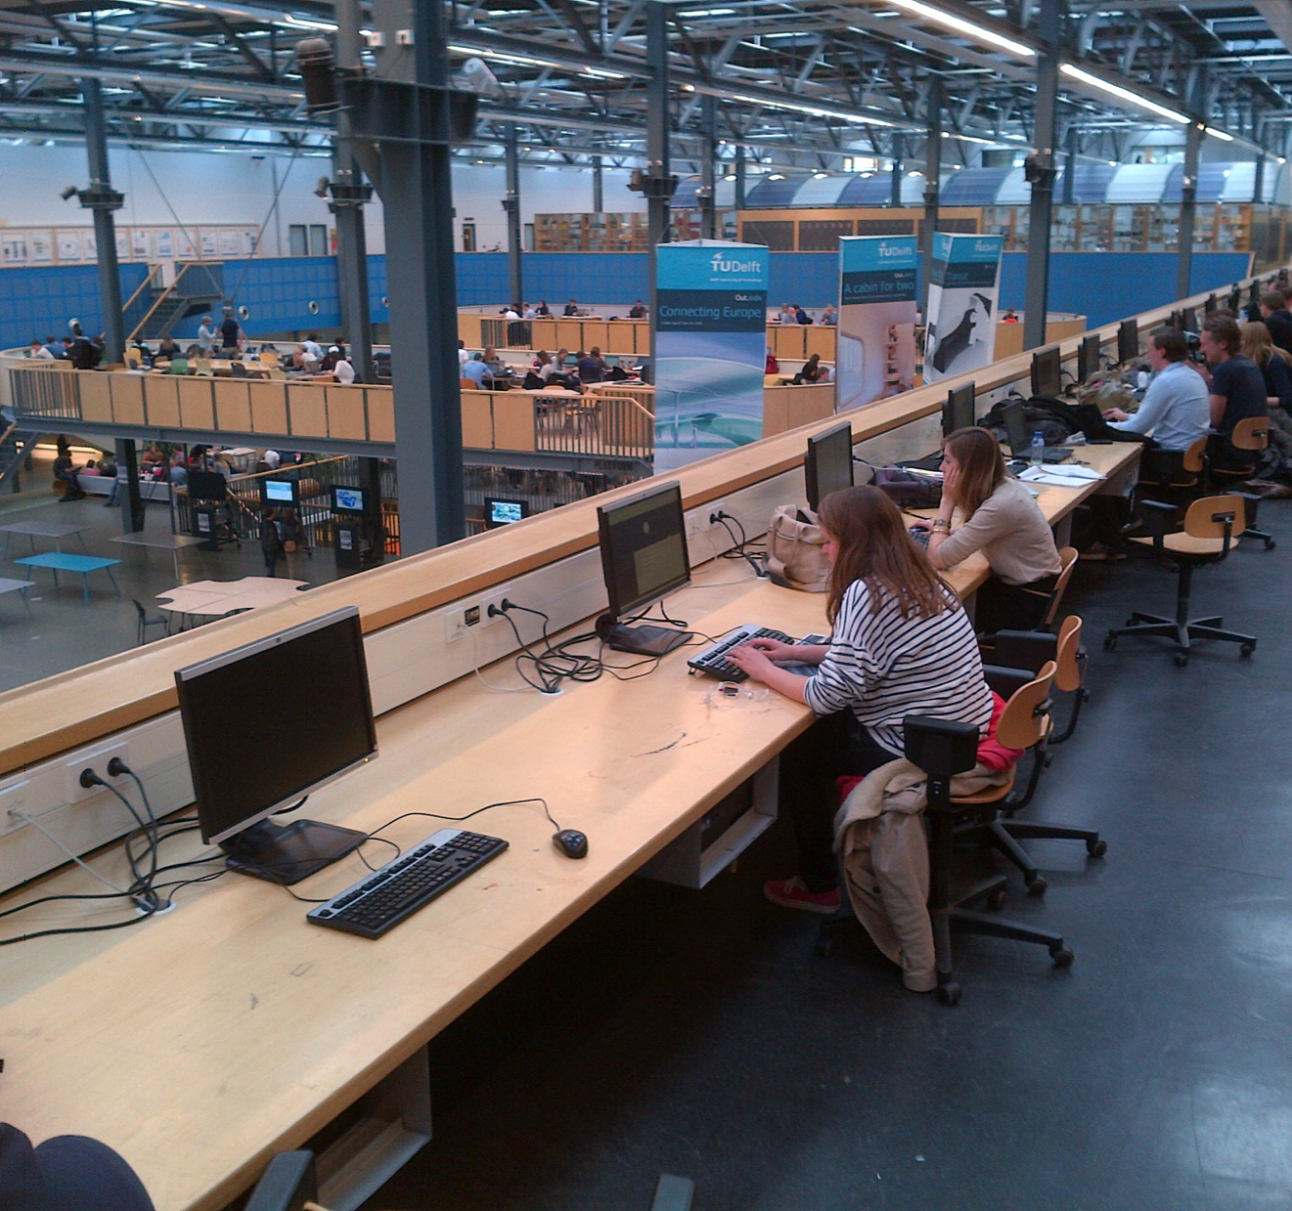

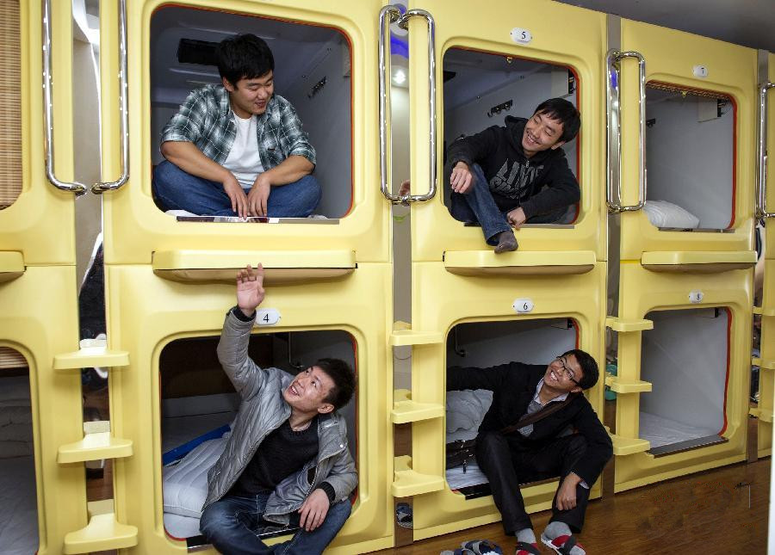
247365 Model: Collaborative Design Working Across all Time Zones

Slide 52
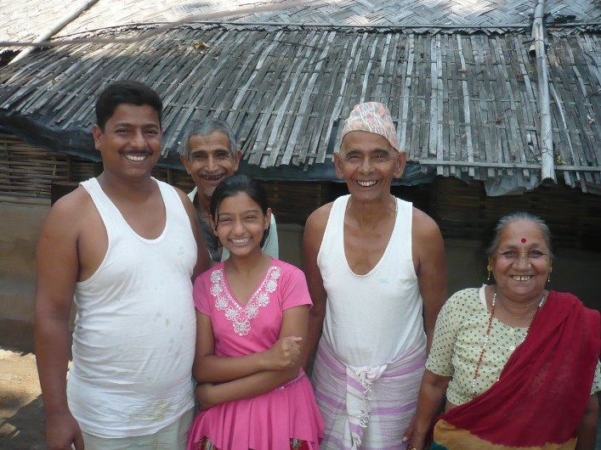
Happy, Healthy, Educated, Dignified and Loving Family

Slide 53

“ A Billionaire is one who improves the lives of a Billion People “
Notes:
Gears come in machine part
We want to put in the gears and grease to get the development machine running

