Slide 1
Assertive, Not Aggressive: The Sweet Spot of Leadership
UIA Associations Round Table Europe 2016
Susan West
Leadership & Change
Executive Master in International Association Management
Solvay Brussels School of Economics & Managment

Slide 2
http://www.jacquielawson.com/notecards/pickup/6344419373772?source=jl999

Slide 3
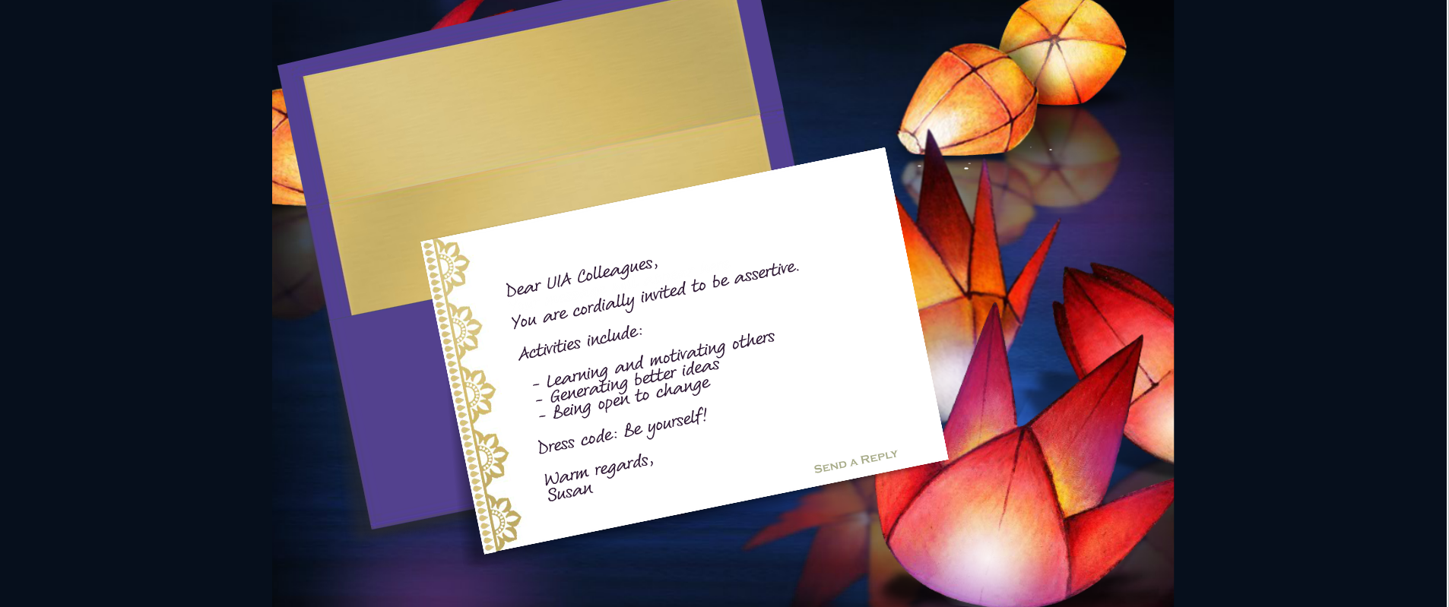
Invitation to Think and Act Differently

Slide 4
Welcome to Our World

Slide 5
Lena’s Case Study: Volunteers MIA
WHAT I THINK AND FEEL, BUT DON’T SAY | HOW THE REAL CONVERSATION WILL LIKELY GO
She knew this was planned for months and didn’t tell me! This happened once already. I’m so tired of these excuses; why does she not delve deeper to really understand what is going on? How can I make her see this? “Aaaaaggggh , I am getting so tired of this negativity, what is she doing here? Everything is &!#% all the time. I don’t want to get angry. We can’t wait. Claire is really good with the volunteers and always seems to pull through in the end. Pfft I am going nuts, how I can I get through to her? Is she taking advantage of me? I want to give up. | Lena (me): “Claire what happened with the volunteers not showing up again for the briefing I scheduled this week? Didn’t they commit?” Claire: “ Well you know that we had some problems getting them motivated to put time into this. It’s on top of their day job.” Lena (me) : “What are the volunteers saying is their reason for not moving forward with this? Do they need more than 3 months advance notice? Aren’t they passionate about this work?“ Claire: “Well you know trying to plan ahead more than 3 months is like looking in a crystal ball. Maybe you can try again next month.” Lena (me): I have to get this briefing done first before I can move ahead with other things. It’s kind of a problem for me. Can you maybe try to reschedule in a week or two? Claire: Well you know I’m not their boss, etc., etc. Lena (me): We have to make this happen. Maybe I can send a Doodle calendar invite today so we work around their availability.

Slide 6
What Lena Left Out
« Lost in Translation »
THINKING & FEELING
BEHAVIOR
THE IMPACT
What key messages or thoughts did you leave out of the conversation?
“Something has to change”
“She (Claire) has to change”
“I am so frustrated!!!”
What did you say or do instead during the conversation?
Asked questions
Soft approach
Offered a solution
Gave in and took the work on myself
Impact on others?
She thinks it’s not a big deal
Lack of understanding of issue
Free from her responsibility
Impact on you?
Don’t get what I need
Pressure from my boss
Frustration
Weakened me in others’ eyes
Impact on association?
Mis-management of precious resources
Delays on key initiative
What WAS SAID
Thought & Felt BUT DID NOT SAY

Slide 7
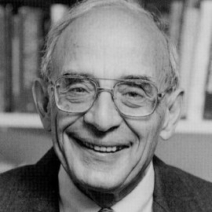
Did You Know…?
Over 25,000 leaders observed in organizations across the globe.
What we learned:
Leaders unintentionally sabotage themselves with self-limiting behaviors and patterns of thinking.
Under moderate pressure, leaders fail to achieve the desired outcomes despite knowing what to do.
It’s not a knowledge gap.
So what is it about us humans that causes this to happen?
Chris Argyris
Professor Emeritus
Harvard Business School

Slide 8
Model I – The Inherited Model
Model I
Suppress negative feelings toward others
Be rational, leave out your emotions
Remain in unilateral control
Win, don’t lose
All people in all cultures exhibit Model I behaviors under pressure

Slide 9
Model II – A Liberating Alternative
Model I
Values
Suppress negative feelings toward others
Be rational, leave out emotions
Remain in unilateral control
Maximize “winning,” minimize “losing”
Model II
Values
Discuss the real issues, use valid information
Productively express thoughts & feelings
Share ownership of problems & solutions
Be Open to others’ ideas
Adapted from works of C Argyris, DA Schön

Slide 10
A Tool for the Toolbox - Productive Dialogue
ASSERTIVE
PASSIVE (too much listening, accommodating, not sharing your view & reasoning)
AGGRESSIVE (advocate your own view, often without reasoning and then jumping to action)
LISTENING
Understand their views, learn
POINT OF VIEW
Your view or opinion
“My view is…”
“I’m seeing a pattern…”
“I’m worried that…”
INQUIRY
Open questions
“What do you think?”
“What’s your reaction?”
REASONING
Data, feelings & stakes
“I say this because…”
“The risk could be…”
Source: Cambridge Leadership Group, inspired by the work of Chris Argyris, Prof. Emeritus, Harvard Business School

Slide 11
3 Things to remember:
Use facts and feelings. It creates learning and motivation to change.
Be curious about how people reach their conclusions. Ask powerful questions. It generates better ideas and buy-in.
Be as open to having your mind changed, as you want the others to be. It builds authentic relationships based on trust and understanding.
When you balance advocacy and inquiry, you can be assertive without coming across as aggressive.

Slide 12
Thank you, hope to see you soon!

