Slide 1
Your Organization in the Communication Age: What is Your Story?
Marisha Wojciechowska-Shibuya Active Member, Union of International Associations

Slide 2
Storytellers, by the very act of telling, communicate a radical learning that changes lives and the world: telling stories is a universally accessible means through which people make meaning.
- Chris Cavanaugh
Notes:
Key word in this quote is story.
Communication is telling a compelling story.
Communication is most effective if you see it as telling a story.

Slide 3
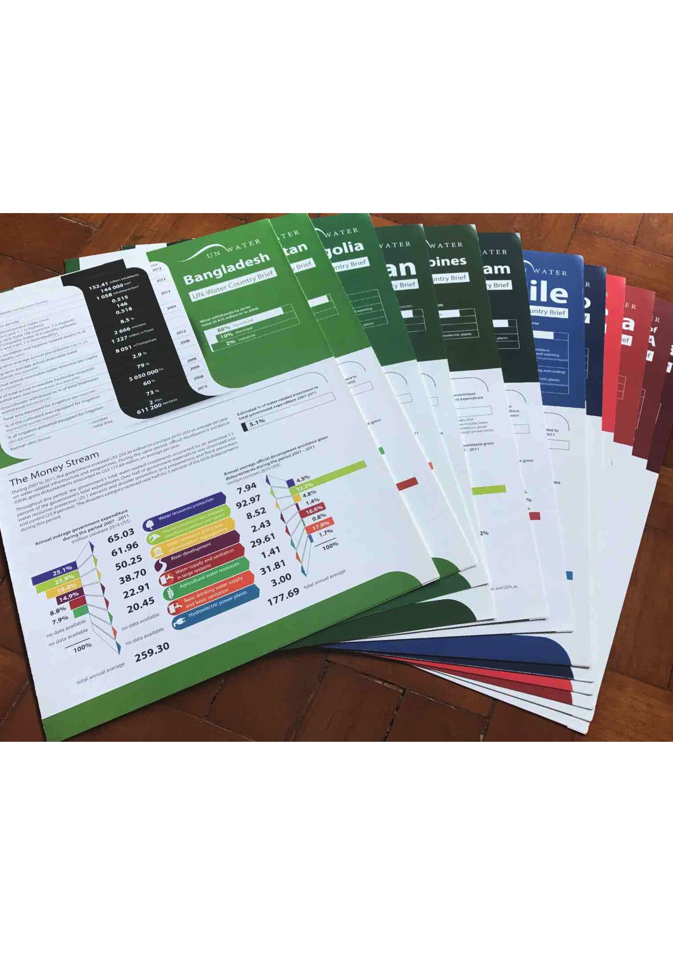
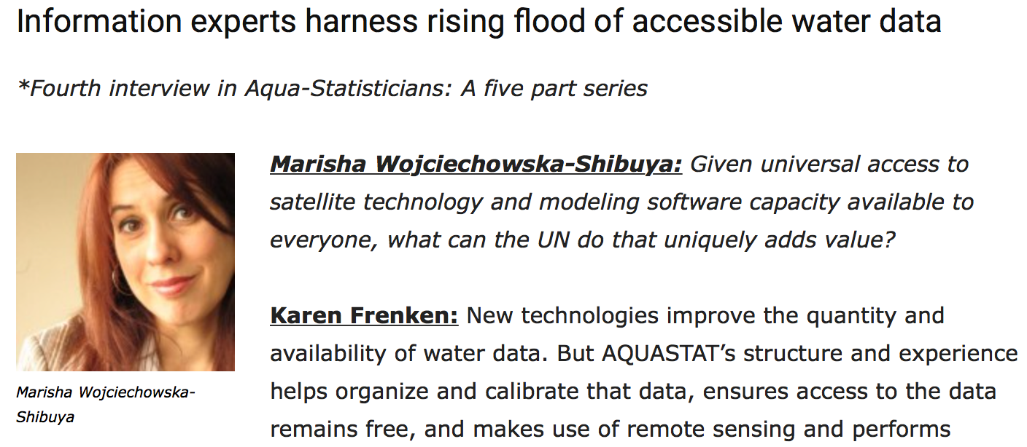
My story…
Notes:
Produced reports
Conducted interviews
Published books
Written articles
Even… edited an online news web service

Slide 4
Your story?
Notes:
But today, it’s not about me… It’s about you!

Slide 5
What do you see?
1) facts and accurate, reliable evidence
2) now, it is pretty easy to get your story out
3) bring attention - help your organization sustain itself - grow
Notes:
The world needs facts and evidence desperately. You are a witness and your perspective matters!
Will give you some ideas on how to do this.

Slide 6
A world of possibilities
interview an expert
write an opinion piece
self-publish an article on LinkedIn
post facts, statistics and/or document through photos on your organization’s social media accounts
create a blog
Notes:
Will go through some of these in more details

Slide 7
Get started!
What? Your subject
Why? Your aim
For who? Your audience
Choose your medium
Notes:
WHAT: your organization already has a mission!
WHY:
Do you want to bring attention to an issue? Do you want to increase your membership? Do you want to enhance your organization’s reputation and standing? Do you want to attract donors or clients?
WHO?
Policy-maker = policy brief, interview, opinion piece
General public = photo log, blog, interview
Technical experts = article

Slide 8
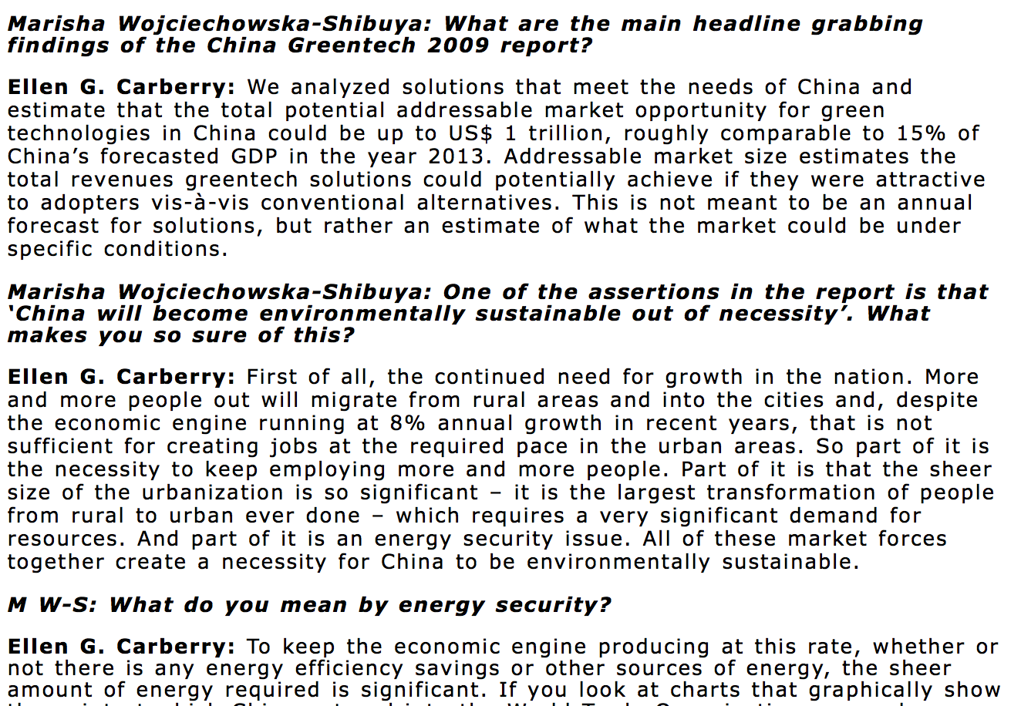
Experts
Notes:
You can use experts in different ways: opinion piece, interview

Slide 9
Visuals
Photo story
Chart
Notes:
- If you can document through photos.
- If you have charts, data, statistics: focus on a short question around a single, key, visual issue or statistic. Then, work your way backward to illustrate and explain how you reached your conclusion

Slide 10
Publish
Self-publish
https://www.linkedin.com/help/linkedin/answer/47538/publishing-articles-on-linkedin?lang=en
Pitch it
Notes:
LinkedIn (but there are others):
click on ‘Write an article’ on your homepage); add charts, photos, videos.
Pointer for publishing online content: rather than draft a big long piece where you pour everything you know in one go, break it up into a series of distinct 300 to 500-word analyses
Golden rule: Truth & Accuracy

Slide 11
Some resources
Conducting interviews: search “tips on how to conduct interviews”
Writing articles: search “how to tweet / blog / write an article”
Online publishing: “how to publish on the internet”

Slide 12
Storytellers, by the very act of telling, communicate a radical learning that changes lives and the world: telling stories is a universally accessible means through which people make meaning.
- Chris Cavanaugh

Slide 13
Thank you!
marisha@pbpi.com

