Slide 1
STAYING ALIVE, WITH OR WITHOUT FUNDING
Margareth Sembiring,
Secretariat, the Consortium of Non-Traditional Security Studies in Asia,
S. Rajaratnam School of International Studies, Singapore

Slide 2
Brief Story
Consortium of Non-Traditional Security Studies in Asia
Who are we?
Est. 2007
Ford Foundation
31 members across the Asia Pacific
What do we do?
Transnational Crime
Food Security
Climate Change
Irregular Migration
Drug Trafficking
Natural Disasters
Health Security

Slide 3
Challenges
Funding
Secretariat Commitment
Members Commitment

Slide 4
Challenges (cont’d)
Funding
Secretariat Commitment
Members Commitment

Slide 5
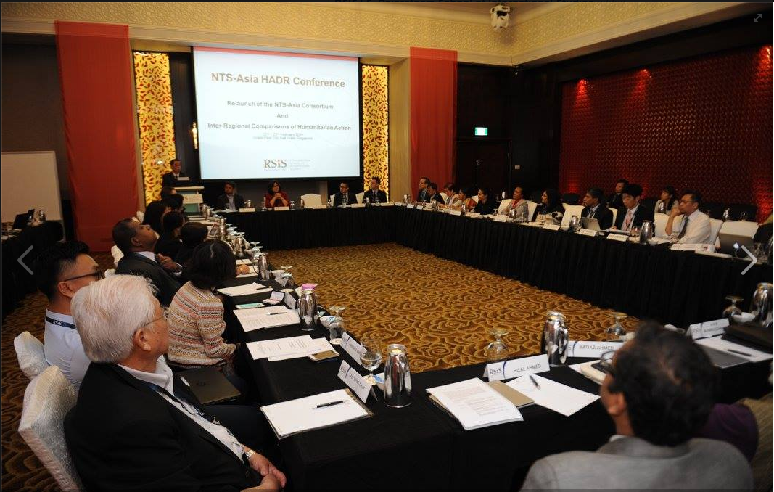
Survival and Revival
NTS-Asia Consortium Relaunch, February 2016

Slide 6
Survival and Revival (cont’d)
Dedicated webmaster and new NTS-Asia Consortium Website rsis-ntsasia.org , November 2016

Slide 7
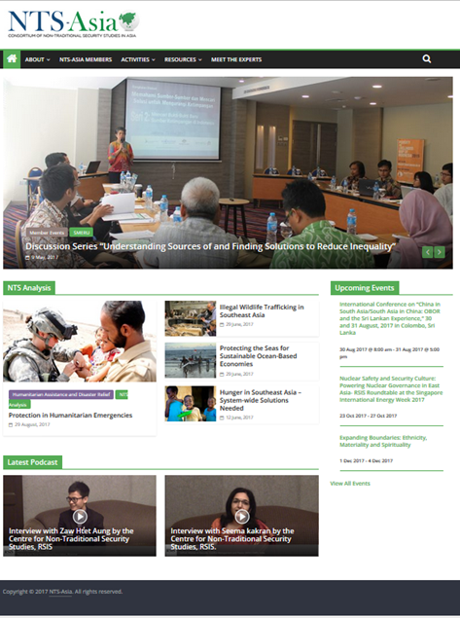
Survival and Revival (cont’d)
rsis-ntsasia.org

Slide 8
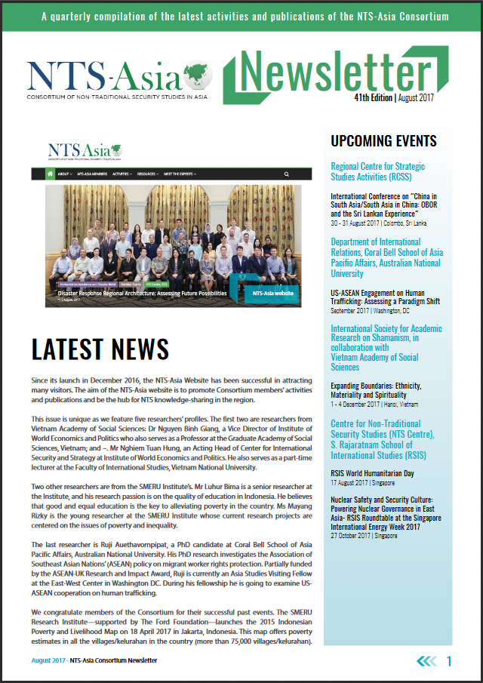
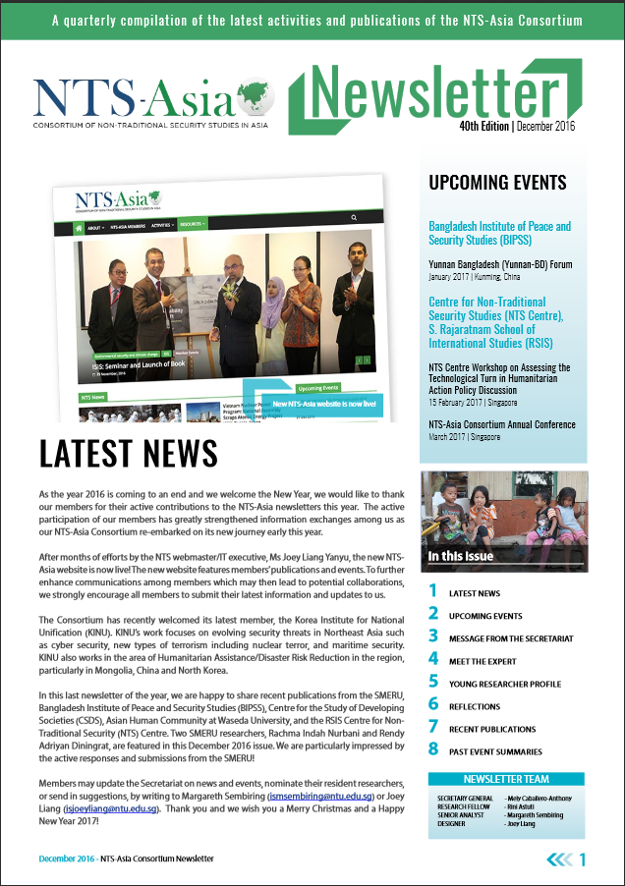
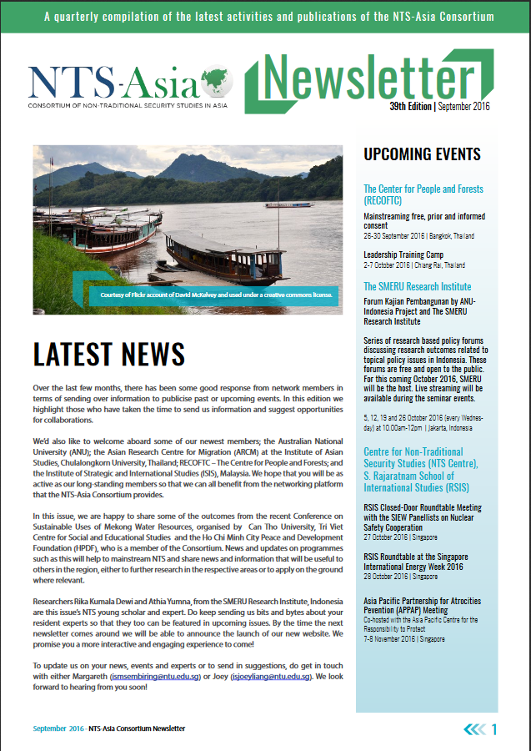
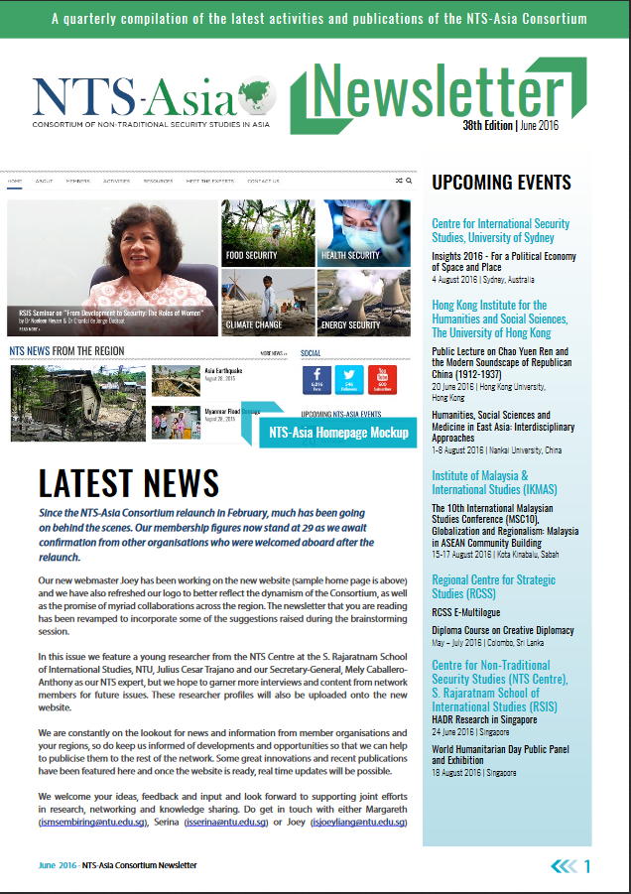
Survival and Revival (cont’d)
NTS-Asia Newsletters

Slide 9
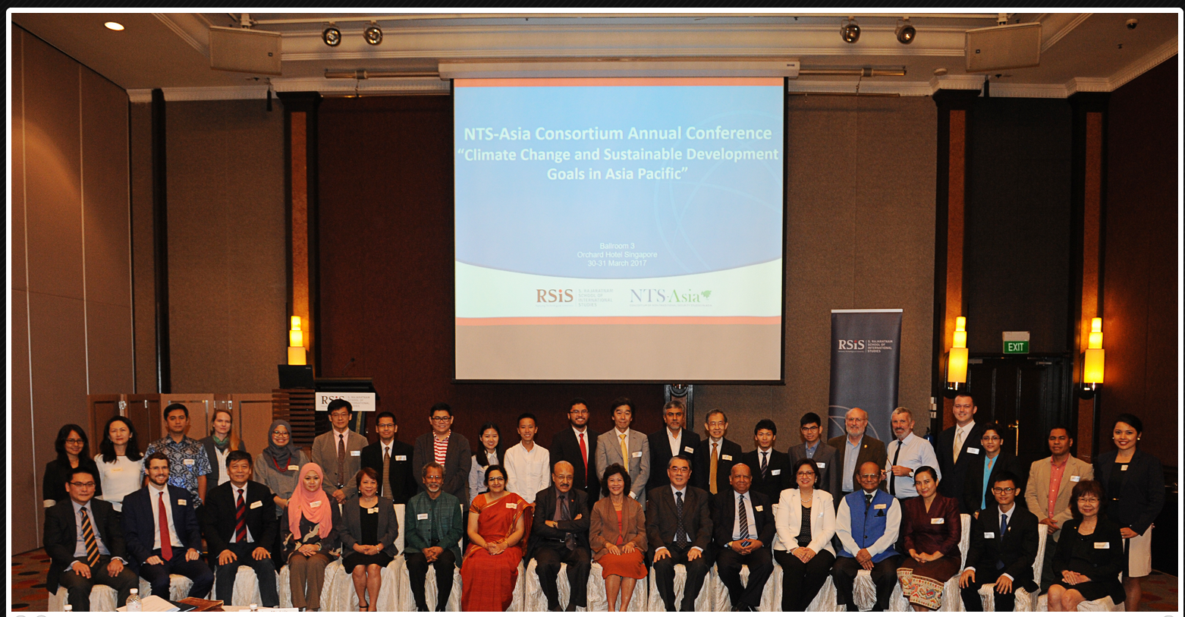
Survival and Revival (cont’d)
NTS-Asia Consortium Conference, March 2017

Slide 10
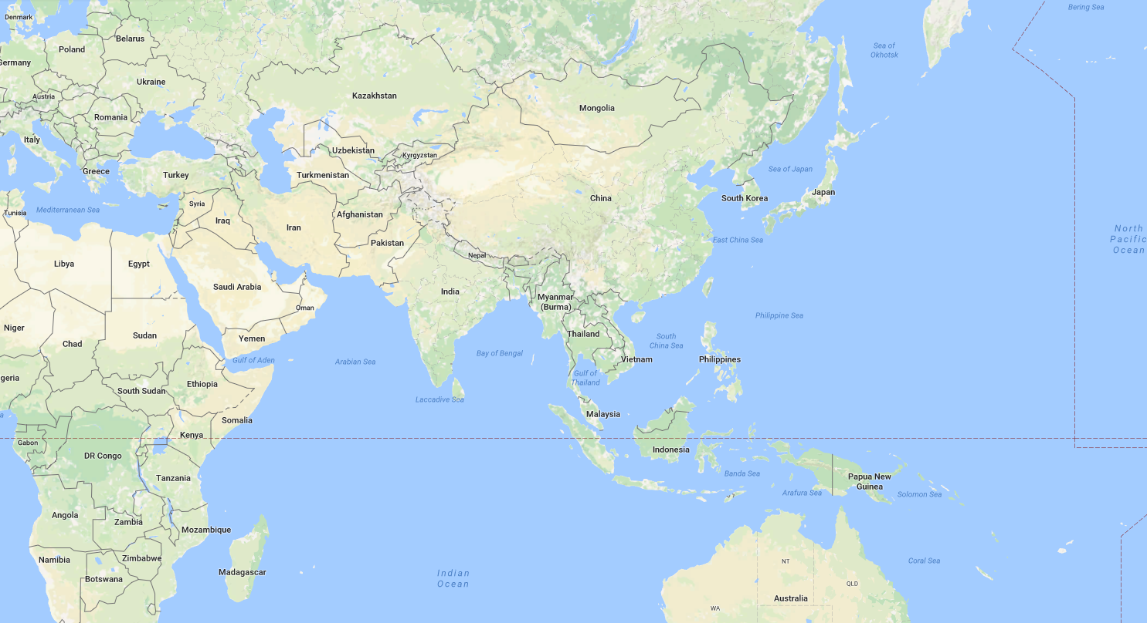
Survival and Revival (cont’d)
Members Grown from 20 (end of 2015) to 31 (as of Sept 2017)

Slide 11
Survival and Revival (cont’d)
Members engagement
Implement discussion points at the annual conference

Slide 12
Survival and Revival (cont’d)
Members engagement
Implement discussion points at the annual conference
Secretariat’s commitment and team-work spirit

Slide 13
Thank You!

